Slide 1
Unit Cells
Chapter 3

Slide 2
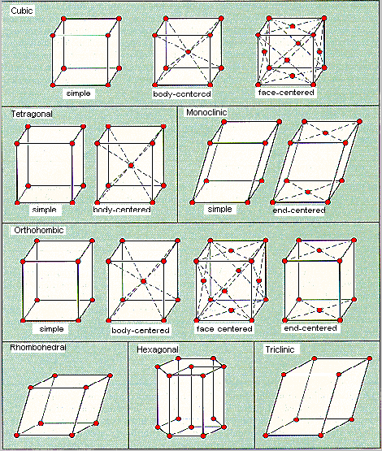
Additional Unit Cells
There are seven different crystal systems that exist
Unit cells differ depending on whether edge lengths and/or angles are equivalent
Also represented in Table 3.2 of text

Slide 3
Relating Edge Length to Atomic Radius
Analysis of the unit cell allows the derivation of formulas relating edge length to atomic radius:
Simple Cubic
BCC
FCC

Slide 4
Calculation of Atomic Packing Factor (APF)
APF = Volume occupied by atoms/Volume of unit cell
APF differs between unit cells:
Simple Cubic: 0.52
BCC: 0.68
FCC: 0.74
Empty volume that is unoccupied by atoms leaves room for interstitials

Slide 5
Crystallographic Point Coordinates
It is possible to describe the location of any point within a unit cell through the use of an x, y, z coordinate system
Same basic idea as Cartesian coordinates; however, the axes are not always perpendicular to one another

Slide 6
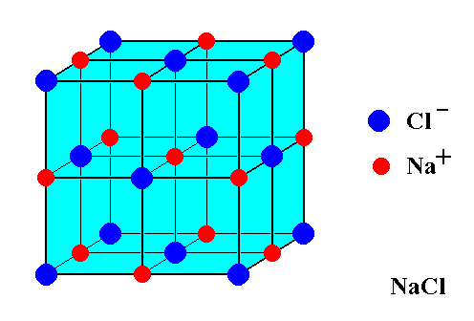

Slide 7
0.46 nm
0.48 nm
0.40 nm

