Slide 1
Aqueous Reactions and Solution Stoichiometry

Slide 2
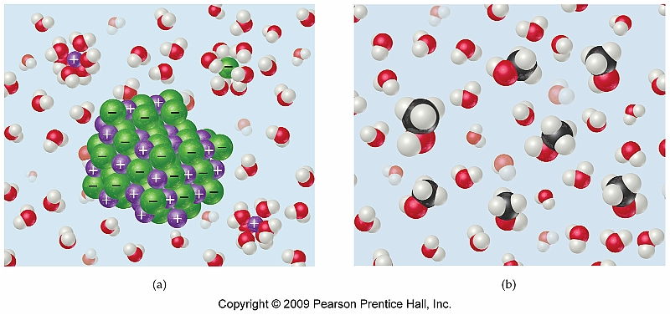
Section 4.1 General Properties of Aqueous Solutions
All solutions consist of a solute and a solvent
Solvent consists of the bulk material and makes up most of the volume of the solution
Solute exists as the minor constituent

Slide 3
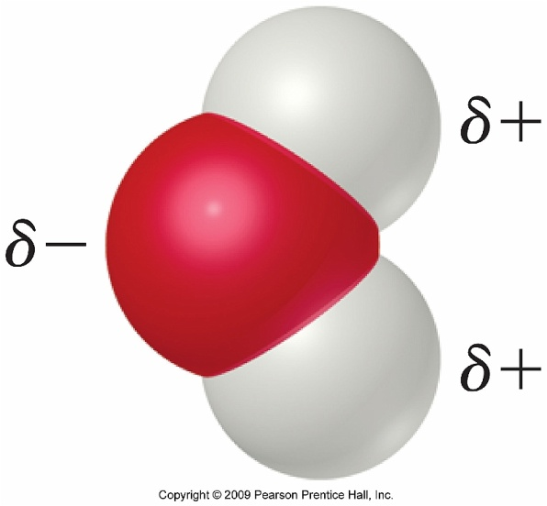
Solvation Process
The solvation process for any ionic compound involves the stabilization of both the cation and the anion.
For molecular compounds those that contain polar groups are more soluble than those that do not
Example: CH₃OH vs. C₄H₁₀

Slide 4
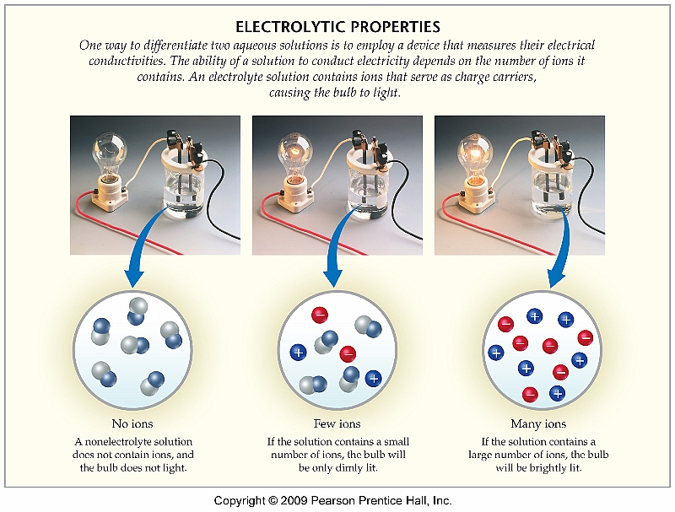
Electrolyte vs. Nonelectrolyte
Electrolytes are solutes that dissociate into ions in an aqueous solution and are capable of conducting electricity
Nonelectrolytes are made up of molecular compounds, that while may be soluble in aqueous solution, do not conduct electricity

Slide 5
Strong vs. Weak Electrolytes and Chemical Equilibrium
While most ionic compounds are electrolytes, some molecular compounds are weak electrolytes as well
Many of these weak electrolytes are known as organic acids
Weak electrolytes exist in a chemical equilibrium:
CH₃COOH(l) CH₃COO⁻(aq) + H⁺(aq)

Slide 6
Examples
Strong Electrolytes
HCl
NaCl
CaCl₂
NH₄Cl
KNO₃
Weak Electrolytes
CH₃COOH (acetic acid)
C₆H₅COOH (benzoic acid)
NH₃ (ammonia)
C₅H₅N (pyridine)

Slide 7
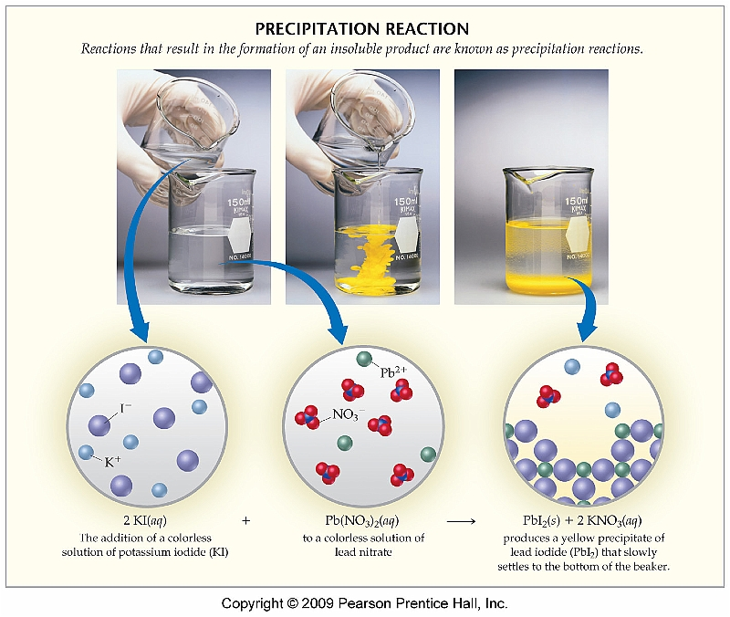
Section 4.2 Precipitation Reactions
One type of reaction that can occur in aqueous solution is known as a precipitation reaction
One compound is formed which is insoluble in aqueous solution and therefore precipitates

Slide 8
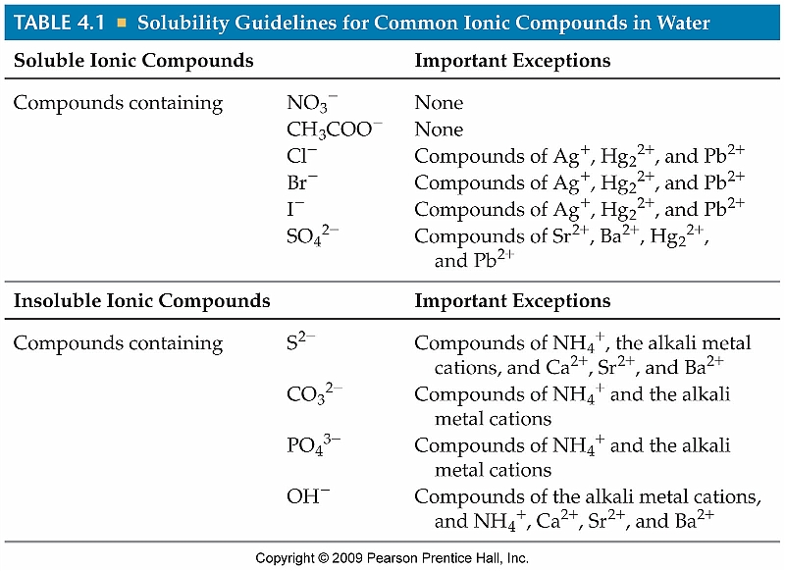
Solubility Rules

Slide 9
Using Solubility Rules
Predict whether each of the following will be soluble or insoluble:
Ba(NO₃)₂
PbSO₄
LiOH
AgCl
See Sample Exercise 4.2 (Pg. 125)
All nitrates are soluble and Ba⁺² is not an exception ; therefore Ba(NO₃)₂ is soluble
All sulfates are soluble except Sr⁺², Ba⁺², Hg₂⁺², and Pb⁺²; therefore PbSO₄ is in insoluble
All hydroxides are insoluble and Li⁺ is an exception; therefore LiOH is soluble
All chlorides are soluble except Ag⁺, Hg₂⁺², and Pb⁺²; therefore AgCl is insoluble

Slide 10
Metathesis Reactions
A metathesis reaction involves the exchange of cations and anions to form new compounds
Guidelines for writing and balancing metathesis reactions:
Use the chemical formulas of the reactants to determine the ions that are present
Write the chemical formulas of the products by placing the cation of one reactant with the anion of the other
Balance the equation

Slide 11
Predicting Metathesis Reactions Using Solubility Rules
Predict whether an insoluble product forms via reaction between the following pairs of compounds by using the solubility rules from Table 4.1.
Pb(NO₃)₂ and sodium
carbonate
ammonium bromide
and cobalt (II) sulfate
potassium hydroxide and
copper (II) chloride
See Sample Exercise 4.3 (Pg. 126)

Slide 12
Net ionic equations
Writing net ionic equations involves determining what ions take part in a metathesis reaction
In order to determine a net ionic equation a total ionic equation must first be written

Slide 13
Steps to Writing Net Ionic Equations
Write the products of the metathesis reaction
Break each soluble reactant or product into its constituent ions
Cross ions that appear on both sides of the equation
The remainder of the species constitutes the net ionic equation

Slide 14
Examples
lead (II) nitrate reacts with potassium iodide
sodium nitrate is mixed with potassium chloride

Slide 15
Spectator Ions
Those ions that do not take place in the reaction are known as spectator ions
Appear (in the same physical state) on both sides of the reaction
Pb⁺²(aq) + 2NO₃⁻(aq) + 2K⁺(aq) + 2I⁻(aq) →
PbI₂(s) + 2K⁺(aq) + 2NO₃⁻(aq)
Pb⁺²(aq) + 2I⁻(aq) → PbI₂(s)
Net Ionic Equation

Slide 16
Acid/Base Reactions
Acids are compounds that, when placed in aqueous solution, produce H⁺ ions
Ex: HCl(g) → H⁺(aq) + Cl⁻(aq)
Bases are compounds, that when place in aqueous solution, produce OH⁻ ions.
Ex: NaOH(s) → Na⁺(aq) + OH⁻(aq)

Slide 17
Neutralization
A reaction between an acid and a base is referred to as a neutralization reaction
Always produces water (H₂O) and a salt
HCl(aq) + NaOH(aq) → NaCl(aq) + H₂O(l)
Acid
Base
“Salt”
Water

Slide 18
Net Ionic Equ. for Neutralization
HCl(aq) + NaOH(aq) → NaCl(aq) + H₂O(l)
Acid
Base
Salt
Water
Total Ionic Equation
H⁺(aq) + Cl⁻(aq) + Na⁺(aq) + OH⁻(aq) →
Na⁺(aq) + Cl⁻(aq) + H₂O(l)
Net Ionic Equation
H⁺(aq) + OH⁻(aq) → H₂O(l)

