Slide 1
Modern Materials
And Junk and Stuff

Slide 2
Materials to be Discussed
Liquid Crystals
Nanomaterials
Quantum Dots
Carbon Nanotubes
Graphene
Polymers
Biomaterials

Slide 3
Nanomaterials—Quantum Dots
The electronic structure of bulk solids was best described using bands to picture the arrangement of MO energy levels
The point at which we have to stop using discreet energy levels and start using band structure turns out to be ~1-10 nm in size
This is the level at which nanostructures are discussed
When synthesizing particles of semiconductors, particles of a size between 1-10 nm are referred to as quantum dots

Slide 4
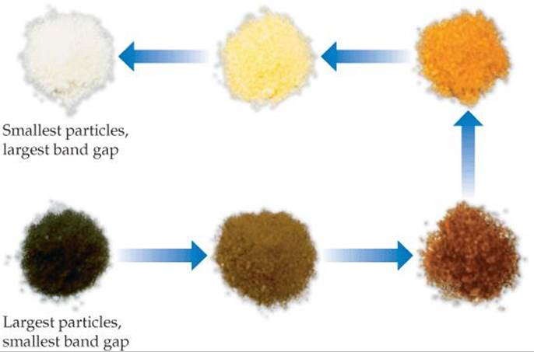
Quantum Dot Properties
As we saw in bulk materials, the size of the band gap changed depending on the size of the sample
This can actually be seen by the naked eye for semiconductors of various size

Slide 5
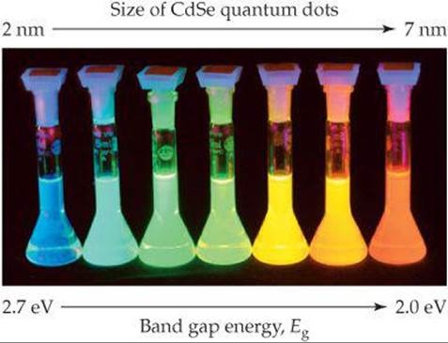
Quantum Dot Emission Properties
Not only do quantum dots absorb light with different wavelength depending on size, they also emit different wavelengths as a function of size

Slide 6
Synthesis of Quantum Dots
In our upcoming lab we will be synthesizing both bulk CdS (> 100 nm) and CdS quantum dots separately
Bulk material will be synthesized by simply adding aqueous solutions of CdCl₂ and Na₂S together
Quantum dots will be synthesized as described later
The main objective of the experiment is not only to synthesize CdS quantum dots but also to determine their average size via UV-Vis spectroscopy

Slide 7
Control of Grown via the Use of Reverse Micelles
The size of the nanoparticles will be restricted via the use of reverse micelles
Reverse in terms of the phases (aqueous vs. organic)
Crystal growth will take place in the micelles and can grow no larger than the micelle allows

Slide 8
Determination of Nanoparticle Size via UV-Vis Spectroscopy

Slide 9
Polymers

Slide 10
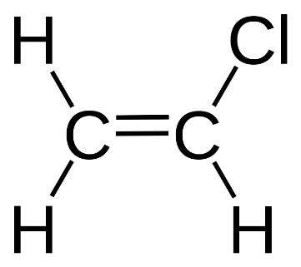
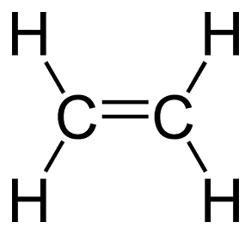
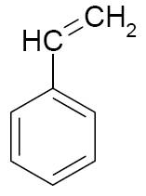
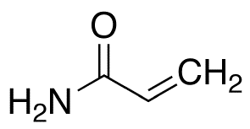
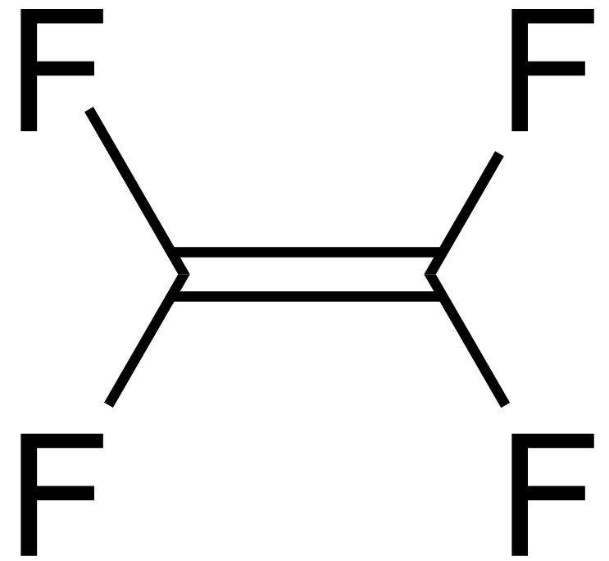
Polymer Construction
Polymers are essentially chains of repeating units (monomers)
The properties of the individual monomers ultimately give the overall polymer their specific properties.

Slide 11
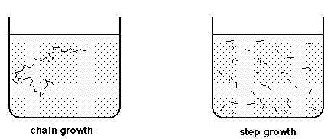
Polymerization Processes
Two common polymerization processes
Chain-growth
Radical polymerization
Living polymerization
Step-growth

Slide 12
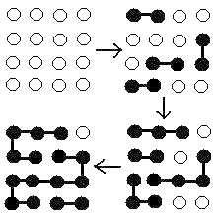
Step Growth Polymerization
Results in a very narrow distribution of molecular weights
Multiple chains form simultaneously that eventually link together to form a very long polymer chain

Slide 13
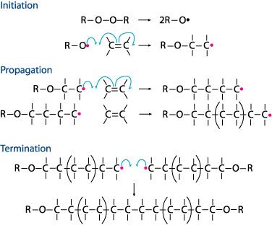
Chain Growth Polymerization
Multiple chains growing individually from one another
Leads to a wide dispersion in individual molecular weights
Involves three distinct stages or steps:
Initiation
Propogation
Termination

Slide 14
Determining Molecular Weight for Polymers
Two different ways to calculate molecular weight for polymers:
Number-average molecular weight
Weight-average molecular weight

Slide 15
Calculating Molecular Weight
Number-average molecular weight
Weight-average molecular weight

Slide 16
Degree of Polymerization
Represents the average number of repeat units in a polymer chain
i.e. describes how long the polymer chains are
Where m = molecular weight of a single monomer unit

Slide 17
Sample Problems
From MS textbook:
# 14.3-14.7 on pgs. 519-520

Slide 18
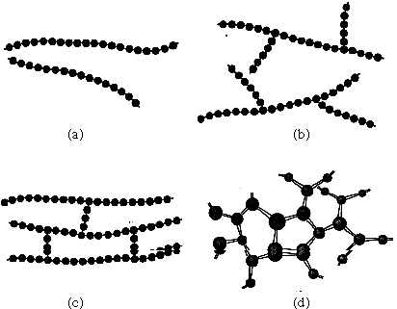
Generic Polymer Types
Linear polymers
Just repeating monomer units in a linear fashion
Branched polymers
Contain smaller chains that branch from a main polymer backbone
Branches may consist of the same monomer as backbone or may be different (see copolymers later)
Crosslinked polymers
Similar to branched polymers; however, branches actually connect adjacent polymer chains
Network polymers
Essentially a highly branched polymer

Slide 19
Stereoisomerism of Side Changes
May polymers have side groups (R groups) that are attached to the monomer units.
As the polymer chain forms these R groups can organize themselves in various three-dimensional arrangements
This three-dimensional organization is known as the polymer’s tacticity.

Slide 20
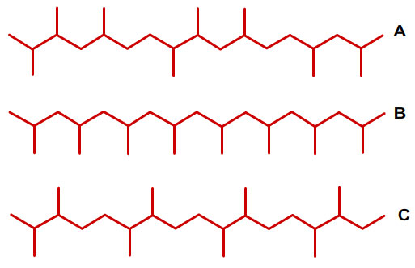
Tacticity
Atactic
Side chains randomly oriented relative to polymer backbone
Isotactic
All side chains on the same side of polymer backbone
Syndiotactic
Side chains alternate sides

Slide 21
Living Polymerization
Living polymerization is a chain growth polymerization that is highly controlled and allows for very narrow distributions in polymer chain lengths
Only possible for certain types of polymers
Can’t be adapted for just any type of polymer system
Through living polymerization processes it is possible to create copolymers
Polymers consisting of two or more different types of monomer units

Slide 22
Types of Copolymers
Random copolymers
Alternating copolymers
Individual monomers have a random distribution throughout the polymer chain
Individual monomers alternate throughout the polymer chain

Slide 23
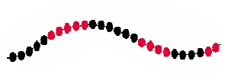
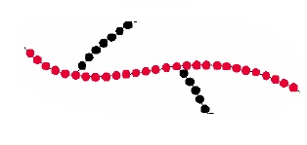
Types of Polymers (cont.)
Block copolymers
Graft copolymers
Monomer A is repeated continually for a block of polymer followed by a block of monomer B
A polymer of monomer A serves as a backbone with side chains of monomer B extending from it

