Slide 1
Nomenclature & Chemical Bonding
Ionic Bonding

Slide 2
Chemical Bonds
When two or more atoms bind together they share their electrons to form a chemical bond
A chemical bond is the force necessary to hold two atoms together
Chemical bonds are classified depending on how those electrons are shared:
Ionic chemical bonds
Covalent chemical bonds

Slide 3
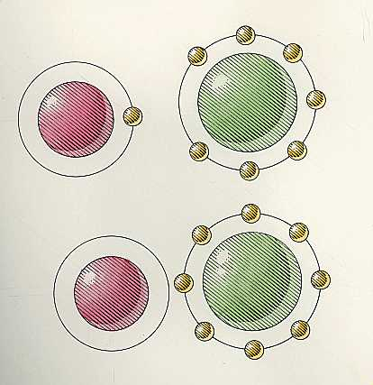
Ionic Bonding
The first topic that we will discuss will be ionic bonding
Ionic bonding occurs when one element completely gives up an electron to a second element
Ex: sodium and chlorine combining to form NaCl
Na
Cl
NaCl
Ionic Bonding

Slide 4
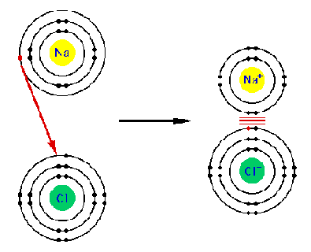
Ion Pairs
Ionic bonds are formed between pairs of ions
One of the ions is always positively charged and the other is always negatively charged
How are ions formed?
Positively charged
Negatively charged

Slide 5
Formation of Ions
Remember the octet rule
The octet rule says that all elements gain or lose electrons in order to obtain a noble gas electron configuration
Therefore elements try to either gain or lose electrons to have a full valence shell (8 electrons)
How do we know if an element is trying to gain electrons or lose electrons?

Slide 6
Formation of Ions
In order to gain an octet of electrons (full valence shell) an atom either gains or loses electorns
To determine whether it gains or loses, ask yourself: Is it easier to lose electrons or gain electrons?
Examples: Na Ca F O

Slide 7
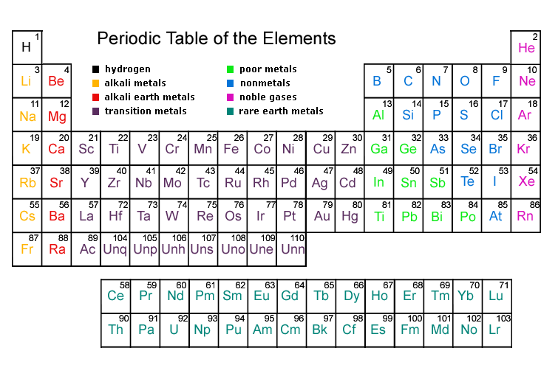
Periodic Table

Slide 8
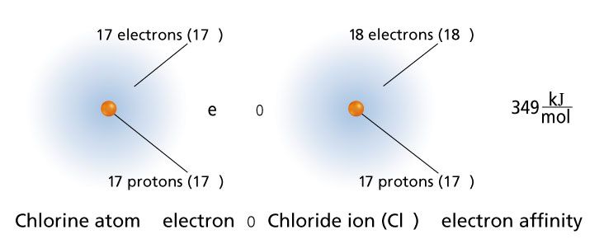
Cations and Anions
An atom becomes positively charged when it loses an electron
We call these cations
An atom becomes negatively charged when it gains an electron
These are called anions

Slide 9
Where do the Electrons Go and Come From?
If atoms gain or lose electrons to form ions, where to these electrons come and go from?
They are either taken away from or given to other atoms
This is done through formation of ionic bonds
Example:
Sodium gives its only valence electron to chlorine to form the ionic compound sodium chloride (NaCl)

