Slide 1
Intermolecular Forces, Solids, and Liquids
Chapter 11

Slide 2
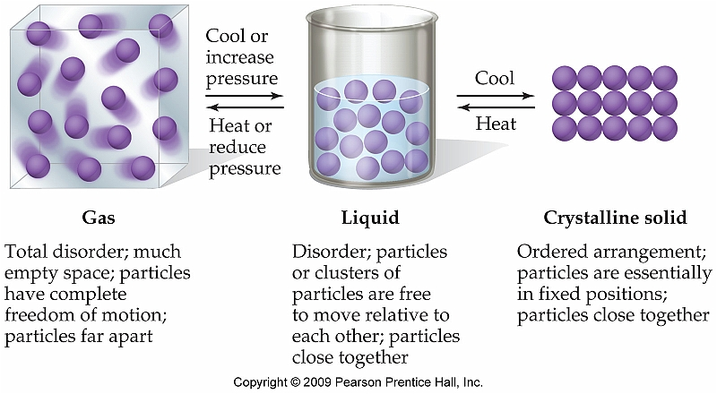
Solids, Liquids, and Gases: A Comparison--Section 11.1
The physical state that a substance is most directly influenced by the amount of kinetic energy present in the substance

Slide 3
Intermolecular Forces Section 11.2
The physical properties of liquids are largely dominated by the effects of intermolecular forces
Vapor pressure
Boiling point
Melting point

Slide 4
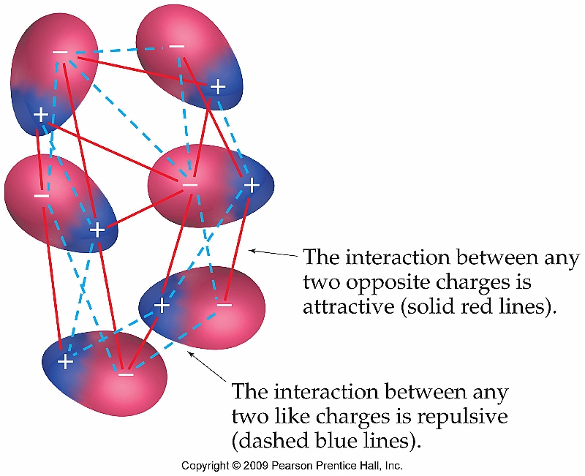
Dipole-dipole Forces
Similar to ion-dipole, but involves the alignment of dipoles of two different polar compounds
The strength of dipole-dipole interactions increases as the strength of the dipole interactions increase

Slide 5
H-Bonding (Special Case of Dipole-Dipole Interaction)
For a H-bond to form the following two criteria must be met:
A covalent bond containing hydrogen must exist (N-H, O-H, or F-H bond)
H-bond donor
A lone pair of electrons must exist
H-bond acceptor

Slide 6
London Dispersion Forces
London dispersion forces exist for every single molecule (both polar and nonpolar)
They are the only intermolecular force present for nonpolar molecules or atoms, however
Strength of dispersion forces depends on the polarizability of the atom or molecule

Slide 7
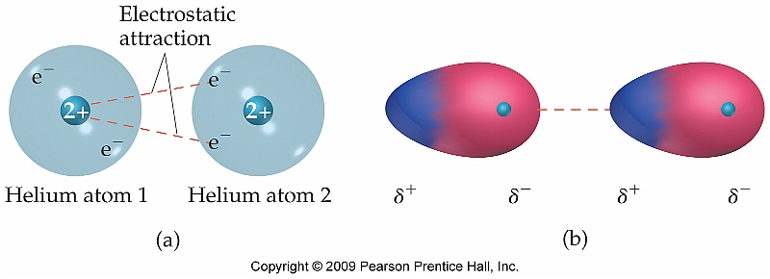
Polarizability
The polarizability of a molecule describes the extent to which the electron distribution can be altered creating an instantaneous dipole
As a result, large atoms or molecules tend to have stronger dispersion forces than smaller

Slide 8
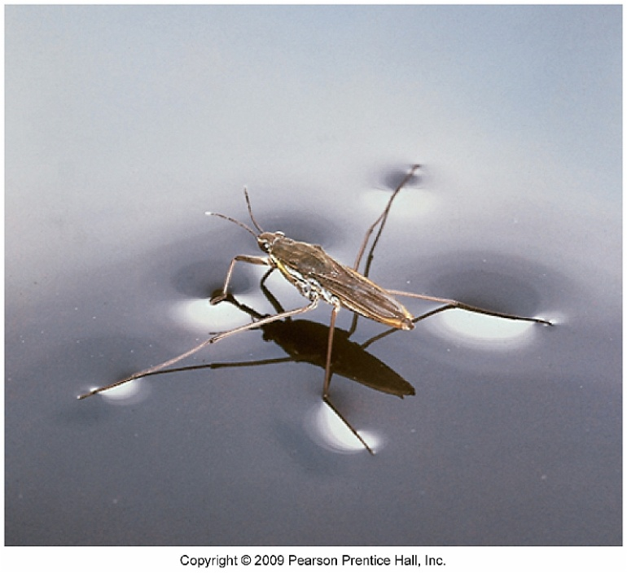
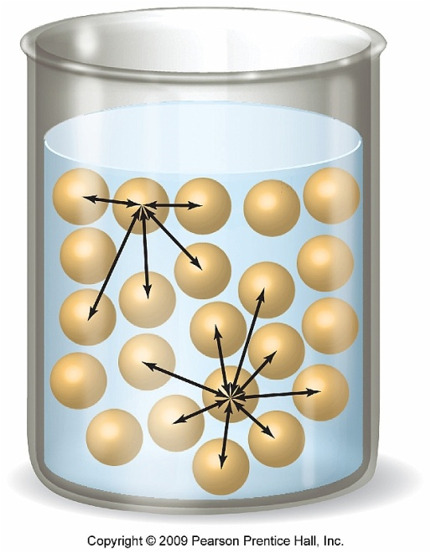
Surface Tension
Surface tension is the energy required to increase the surface area of a liquid
In order to increase the surface area, IMFs must be overcome

Slide 9
Reminder
Whenever physical properties of molecules are compared (i.e. boiling point, melting point, viscosity, vapor pressure, surface tension, etc.), always think about IMFs.
Simply compare the forces present in each scenario and determine which is stronger

Slide 10
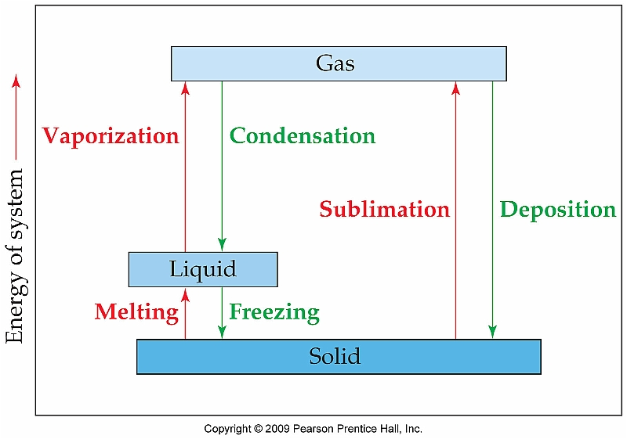
Phase Changes Section 11.4
As the individual particles of a solid, liquid, or gas gain or lose kinetic energy, they may go through a series of phase changes

Slide 11
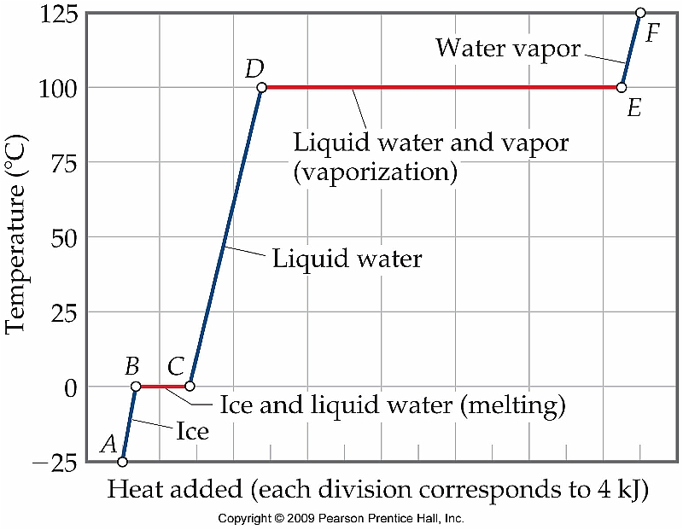
Heating Curves
Heating curve for H₂O

