Slide 1
Thermochemistry
Chapter 6

Slide 2
The Nature of Energy Section 6.1
Kinetic vs. potential energy
Kinetic– associated with the energy of motion
Potential– associated with the energy an object possesses as a result of position
Thermal energy
Energy resulting from the heat content of an object
Related to kinetic energy
Chemical energy
Energy stored in the chemical bonds of a compound

Slide 3
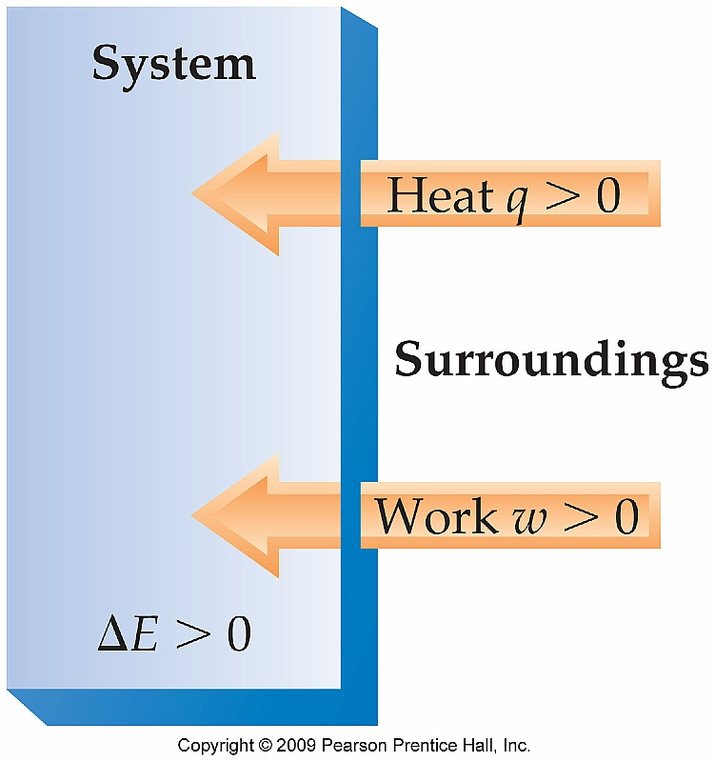
System vs. Surroundings
The field of chemistry focuses on energy changes
Therefore we must be careful to define the system (typically the chemical reaction itself) that is changing and the surroundings that includes everything else

Slide 4
Transferring Energy
Energy can be transferred in two distinct ways:
Work
W = F x d
Heat
Energy transferred from hotter objects to colder ones
No matter how energy is transferred, the First Law of Thermodynamics must be considered:
Energy is conserved
ΔE = E_{final} - E_{initial}

Slide 5
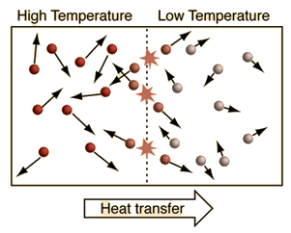
Energy Transfer on the Molecular Level
When high energy particles collide with lower energy particles energy is transferred.
-- Eventually each particle will possess an equal amount of energy (on average)

Slide 6
Heat Transfer Simulation

Slide 7
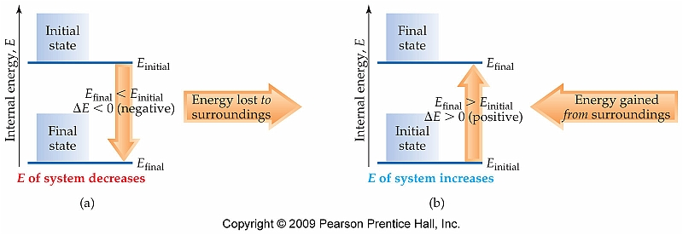
Internal Energy and the Sign of ΔE
The energy contained in a system is a very abstract value and is nearly (if not totally) impossible to measure; however the First Law can be applied without knowing the final and initial energy values:
ΔE = E_{final} - E_{initial}

Slide 8
Relating Changes in Energy to Heat and Work
Because energy can be exchanged by the transfer of both heat and work; the work done on or by the system must be considered also:
ΔE = q + w
The sign of q and w are assigned by the direction of heat or work transfer:

Slide 9
Relating Heat and Work Changes of Internal Energy
Calculate the change in the internal energy of the system for a process in which the system absorbs 140 J of heat from the surroundings and does 85 J of work on the surroundings.
See Interactive Example 6.1 (Pg. 216)

Slide 10
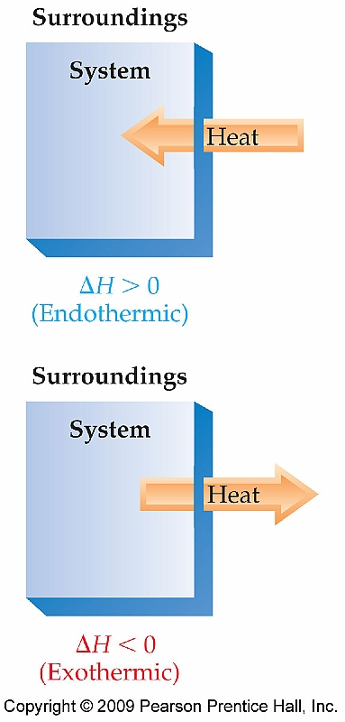
Endothermic vs Exothermic Processes
If only the transfer of heat is considered during the course of a chemical reaction, then chemical reactions can be classified as either endothermic or exothermic
Endothermic—heat absorbed by the system
Exothermic—heat released to the system

Slide 11
Energy as a State Function
The amount of energy contained in a system is referred to as a state function
For state functions it does not matter how you arrive at the final state, only on what that final state is
ΔE is a state function whereas q and w are not

Slide 12
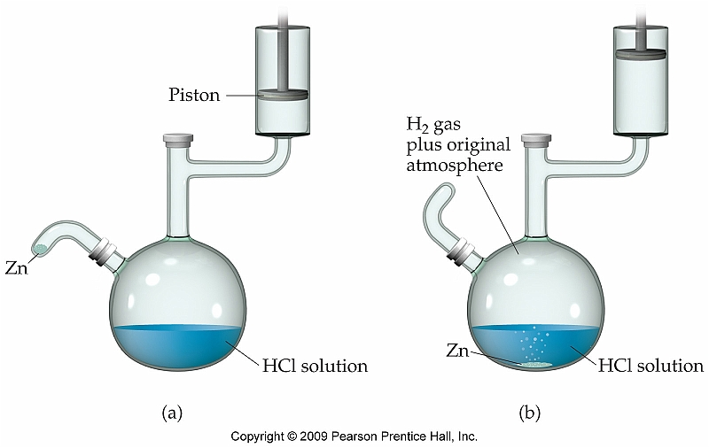
Work Done as a Result of a Chemical Reaction
Examine the following chemical reaction:
Zn(s) + 2H⁺(aq) → Zn²⁺(aq) + H₂(g)
w = -PΔV
If ΔV is positive (increases) work is done by the system
If ΔV is negative (decreases) work is done on the system

Slide 13
Section 6.2 Enthalpy and Calorimetry
Enthalpy is a thermodynamic quantity that accounts for heat flow during the course of a chemical reaction
Equals the energy contained by the system as well as the pressure/volume work done on or by the system:
H = E + PV
Or
ΔH = ΔE + P ΔV

Slide 14
Enthalpy as a State Function
Because enthalpy is a state function and contains the factor ΔE, we can obtain the following expression (at constant pressure only):
$$q_{p}=∆E+P∆V$$
Because the amount of heat energy gained or lost
during the course of a chemical reaction is easily
measured, enthalpy is a much more useful term
than internal energy

Slide 15
Determing the Sign of ΔH
Gaseous water (steam) condenses to form liquid water
Gasoline combusts in the presence of oxygen
The temperature of a solution increases as solute is added

Slide 16
Enthalpies of Reaction
Because enthalpy is a state function, we are not interested in absolute values for H, only the difference before and after a chemical or physical process; therefore:
ΔH = H_{products} – H_{reactants}
Often abbreviated ΔH_{rxn} (heat of reaction)

Slide 17
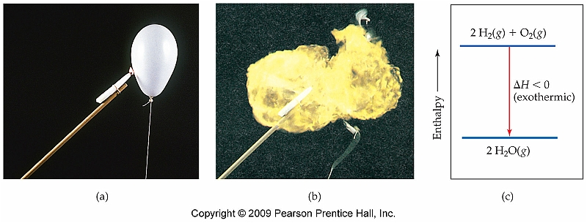
Example
2 H₂(g) + O₂(g) → 2 H₂O(g) ΔH = -483.6 kJ
The above equation is referred to as a thermochemical equation
Energy Diagram

Slide 18
Relating ΔH to Quantities of Reactants and Products
Calculate the enthalpy change if 5.00 g of N₂(g) reacts with O₂(g) to make NO, a toxic air pollutant and important industrial compound, using the following thermochemical equation:
N₂(g) + O₂(g) → 2NO(g)
ΔH = +181.8 kJ

Slide 19
Relating ΔH to Quantities of Reactants and Products (cont.)
Calculate the enthalpy change observed in the combustion reaction of 2.74 g ethane, using the thermochemical equation shown:
2 C₂H₆(g) + 7 O₂(g) → 4 CO₂(g) + 6 H₂O(g)
ΔH = -3120 kJ

Slide 20
Calorimetry
Because ΔH essentially refers to the amount of heat energy absorbed or released during the course of a chemical reaction, it can be determined experimentally using a technique referred to as calorimetry

Slide 21
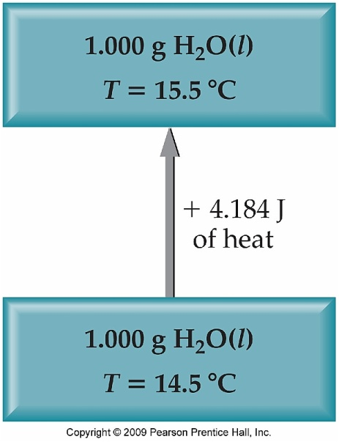
Heat Capacity and Specific Heat
If thermal energy is added to an object it will increase in temperature
The magnitude of that temperature change is referred to as heat capacity, C.
The amount of heat energy required to raise the temperature by 1° C or 1 K.
When 1 gram of a substance is studied, it is referred to as specific heat capacity, C_{s}.

Slide 22
Relating Heat, Temperature Change, and Heat Capacity
What quantity of heat must be added to a 120. g sample of aluminum to change its temperature from 23.0 °C to 34.0 °C? C_{Al} = 0.900 J/g K
What is the molar heat capacity of Al?
See Interactive Example 6.5 (Pg. 222)

Slide 23
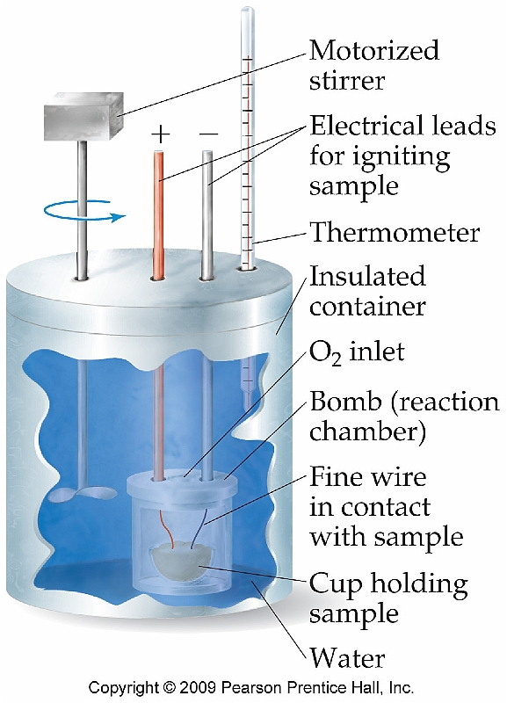
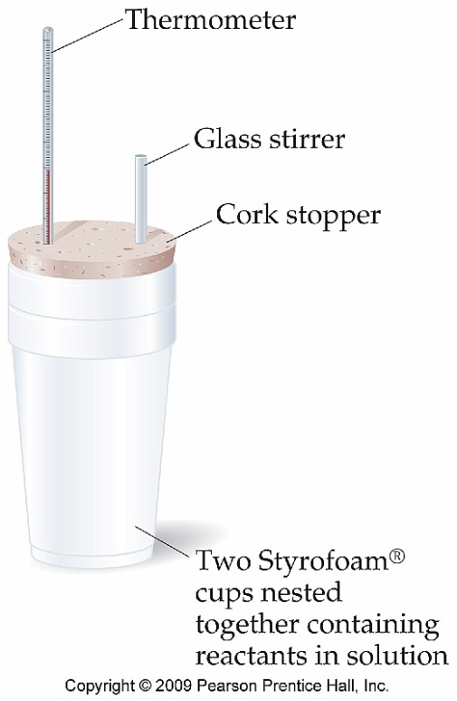
Constant Pressure vs. Constant Volume Calorimetry
The amount of thermal energy released or absorbed by a chemical reaction can be measured in two different ways:
Constant pressure calorimetry
q = mcΔT
Constant volume calorimetry
q_{rxn} = -C_{cal} x ΔT

Slide 24
Constant Pressure Calorimetry
A 50.0 g sample of a dilute acid solution is added t 50.0 g of a base solution in a coffee cup calorimeter. The temperature of the liquid increases from 18.20 °C to 21.30 °C. Calculate q for the neutralization reaction, assuming that the specific heat of the solution is the same as that of water (4.184 J/g °C).
See Interactive Example 6.5 (Pg. 222)

Slide 25
Hess’s Law Section 6.3
Because ΔH is a state function, it does not matter how we arrive at our final state
Therefore if we know ΔH_{rxn} for a series of reactions, we can calculate ΔH_{rxn} for the overall process

Slide 26
Using Hess’s Law to Calculate ΔH
Calculate the enthalpy change for the hydrogenation of ethylene using the following thermochemical equations:
C₂H₄(g) + H₂(g) → C₂H₆(g) ΔH = ?
H₂(g) + ½ O₂(g) → H₂O(l) ΔH = -285.8 kJ
C₂H₄(g) + 3 O₂(g) → 2 CO₂(g) + 2 H₂O(l) ΔH = -1411kJ
C₂H₆(g) + 7/2 O₂(g) → 2CO₂(g) + 3 H₂O(l) ΔH = -1560 kJ
See Interactive Example 6.8 (Pg. 228)

Slide 27
Hess’s Law Example #2
Given the following equations and Hº values, determine the heat of reaction (kJ) at 298 K for the reaction:
2 OF₂(g) + 2 S(s) → SO₂(g) + SF₄(g) ΔH = ?
OF₂(g) + H₂O(l) → O₂(g) + 2 HF(g) ΔH = -276.6 kJ/mol SF₄(g) + 2 H₂O(l) → 4 HF(g) + SO₂(g) ΔH = -827.5 kJ/mol S(s) + O₂(g) → SO₂(g) ΔH = -296.9 kJ/mol

Slide 28
Standard Enthalpies of Formation Section 6.4
Hess’s Law allows us to calculate the enthalpies of reaction for numerous different reactions based on tabulated data
The tabulated data contains enthalpies of formation
More precisely, standard enthalpies of formation, ΔH_{f}° (based on elements in their standard states at 25 °C

Slide 29
Writing Formation Reactions
Examples:
NaCl
Ca(NO₃)₂
C₆H₆O₆
AgCl

Slide 30
Calculating Enthalpies of Reaction Using Standard Enthalpy Changes
Based on Hess’s Law and tabulated enthalpies of formation, the following expression can be used to calculate ΔH°_{rxn}:
ΔH°_{rxn} = Σ ΔH°_{f}(products) - Σ ΔH°_{f}(reactants)

Slide 31
Using Standard Enthalpies of Formation to Calculate Enthalpy of Reaction
One step in the production of nitric acid, a powerful acid used in the production of fertilizers and explosives, is the combustion of ammonia.
4NH₃(g) + 5O₂(g) → 4NO(g) + 6H₂O(g)
Calculate ΔH°_{rxn} using enthalpies of formation listed in Appendix C.
See Interactive Example 6.10 (Pg. 235)

