Slide 1
Chemical Kinetics
Chapter 14

Slide 2
Chemical Kinetics
Kinetics essentially is the study of how fast a chemical process will occur
  i.e. time it takes for a reaction to go to completion
Very useful in terms of industrial processes
  Need to know how fast it takes a reaction to occur

Slide 3
Factors that Affect Reaction Rates
Physical state of reactants
  Higher surface area translates into a faster reaction
Concentration of reactants
Temperature at which reaction occurs
  Higher temperature translates into more kinetic energy (faster moving particles)
Presence of a catalyst
  Lowers the activation energy
** In cases 1-3 above, it is the # of collisions that is affected**

Slide 4
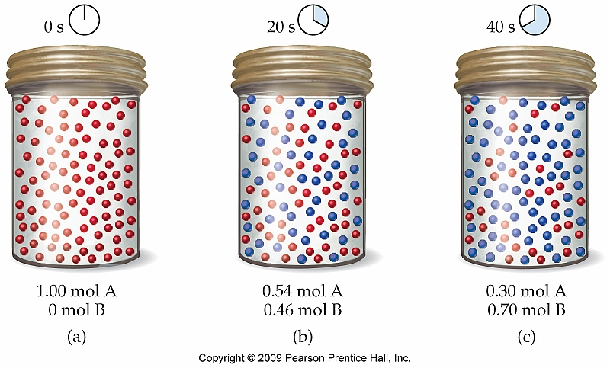
Reaction Rates
A rate is usually expressed as the change in a quantity over time
  Reaction rates are expressed as a change in concentration (mol/L) over time
Let’s consider the following reaction:

Slide 5
Expressing Average Rates of Reaction
The rate at which this reaction proceeds can be expressed in one of two ways:
OR
Minus sign is used simply because reaction rates are typically expressed as positive numbers

Slide 6
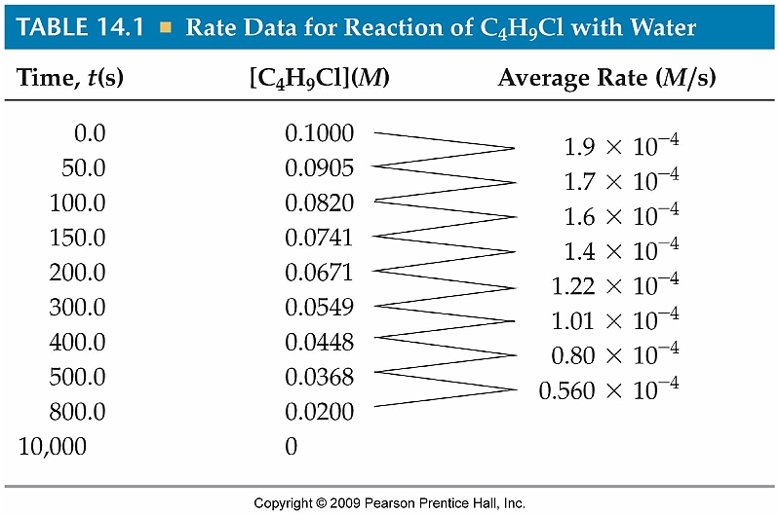
Calculating the Average Rate of Reaction
Using the data shown to the right, calculate the average rate of rate of reaction of C₄H₉Cl with water between 0.0 and 200.0 s.

Slide 7
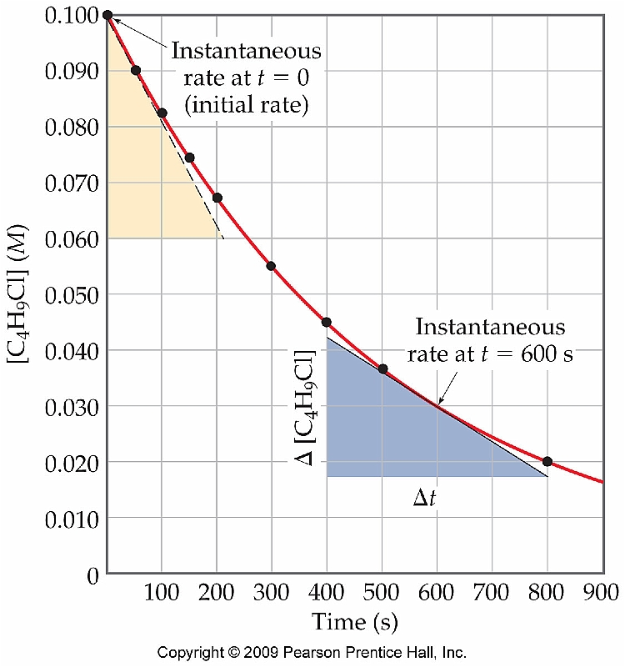
Change of Rate with Time
Graphical comparison of data from the previous slide gives the following plot:
Why does the plot asymptotically approach 0? Why isn’t the plot linear?

Slide 8
Instantaneous Rate
The instantaneous rate of reaction at time, t, can be determined by evaluating the slope of the tangent line to a curve from a plot of [A] vs. time:
What would be the
instantaneous rate of
reaction at 10.0 s?

Slide 9
Instantaneous Rates (cont.)
What would be the instantaneous rate of change for the reaction depicted in this plot at t = 10 s?

Slide 10
Reaction Rates and Stoichiometry
C₄H₉Cl + H₂O → C₄H₉OH + HCl
  C₄H₉Cl disappears as fast as C₄H₉OH appears
What about the reaction below:
N₂O₄ → 2 NO₂
  2 mol NO₂ appear for every one mole of N₂O₄ that disappears:
Rate =

Slide 11
Equating Rates Using Stoichiometry
For the generic reaction:
a A + b B → c C + d D
Example:
C₂H₆ + 7 O₂ → 4 CO₂ + 6 H₂O

Slide 12
Relating Rates of Product Appearance and Reactant Disappearance
Consider the formation of ammonia from the elements:
3 H₂ + 2 N₂ → 2 NH₃
If the ammonia concentration is increasing at a rate of 0.024 M/s, what is the rate of reaction?
What is the rate of disappearance of hydrogen?
See Sample Exercise 13.2 (Pg. 515)

Slide 13
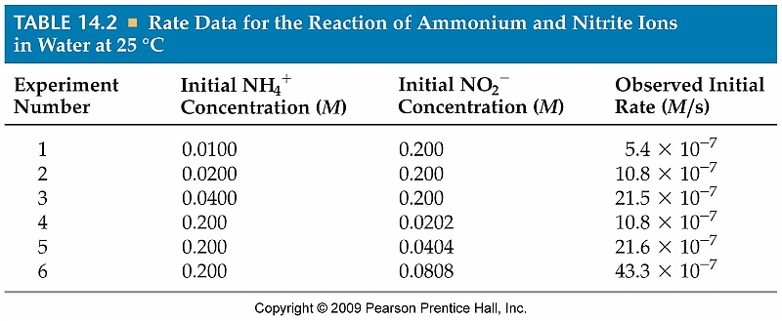
The Rate Law: The Effect of Concentration on Rate
The most common method for studying the effect of concentration on rate is by studying the initial rate of the reaction
  The initial rate is the rate of the reaction at t = 0
  NH₄⁺(aq) + NO₂⁻(aq) → N₂(g) + 2 H₂O (l)

Slide 14
Rate Laws
Because the initial rate of reaction is proportional to the initial concentrations of both NH₄⁺ and NO₂⁻ we can write the following rate law to describe the kinetics for this particular reaction:
Rate = k[NH₄⁺][NO₂⁻]
The constant k is referred to as the rate constant and changes with temperature

Slide 15
Calculating the Rate Constant, k
Choose any single experiment
Once the value for k has been determined, we can calculate the initial rate of reaction under any conditions at that particular temperature
  Ex: 0.150 M NH₄⁺ and 0.121 M NO₂⁻

Slide 16
Reaction Orders
Not every reaction is exactly proportional to the initial concentrations of reactants:
CH₃Cl(g) + H₂O(g) → CH₃OH(g) + HCl(g)

Slide 17
Exponents in the Rate Law
Generally speaking, the rate law for any reaction can be expressed as follows:
Rate = k[reactant 1]^{m}[reactant 2]^{n} …
The exponents in the equation above are referred to as reaction orders
  What would be the reaction order for each reactant in the reactions below:
NH₄⁺(aq) + NO₂⁻(aq) → N₂(g) + 2 H₂O (l)
CH₃Cl(g) + H₂O(g) → CH₃OH(g) + HCl(g)

Slide 18
Overall Reaction Order
The overall reaction order is reported as the sum of each individual reaction order:
2 N₂O₅(g) → 4 NO₂(g) + O₂(g) Rate = k[N₂O₅]
CHCl₃(g) + Cl₂(g) → CCl₄(g) + HCl(g) Rate = k[CHCl₃][Cl₂]^{1/2}
H₂ (g) + I₂ (g) → 2 HI (g) Rate = k[H₂][I₂]

Slide 19
Units of Rate Constants
Because it is possible for different reactions to have different reaction orders, the actual units for the rate constant, k, may be different as well
For a first order reaction:
Rate = k[A]
What would the rate constants for second and third order reactions be?

Slide 20
Using the Method of Initial Rates
When methyl bromide reacts with hydroxide ions in solution, methyl alcohol and bromide ion form:
CH₃Br + OH⁻ → CH₃OH + Br⁻
Determine (a) the rate law for the reaction, (b) the rate constant, and (c) the rate of the reaction when [CH₃Br] = 0.025 M and [OH⁻] = 0.005 M using the information at the right.
See Sample Exercise 13.4 (Pg. 519)

Slide 21
Using the Method of Initial Rates
Use the following experimental initial rate data to determine the rate law and rate constant for the reaction of hydrogen iodide with ethyl iodide.
HI(g) + C₂H₅I(g) → C₂H₆(g) + I₂(g)
What is the rate of the reaction when [HI] = 0.075 M and
[C₂H₆] = 0.33 M?

Slide 22
First Order Reactions and the Integrated Rate Law
The rate law for a first order reaction can be expressed as follows:
By integrating the equation above, we obtain the integrated rate law:

Slide 23
Using the First Order Integrated Rate Law
The pesticide fenvalerate, C₂₅H₂₂ClO₃N, is one of four compounds approved by New York City to combat the mosquitoes that spread West Nile virus. It degrades in the environment with first-order kinetics and a rate constant of 3.9 x 10⁻⁷ s⁻¹. An accidental discharge of 100 kg fenvalerate into a holding pond results in a fenvalerate concentration of 1.3 x 10⁻⁵ M. Calculate the concentration 1 month (2.6 x 10⁶ s) after the spill.
See Sample Exercise 13.6 (Pg. 525)

Slide 24
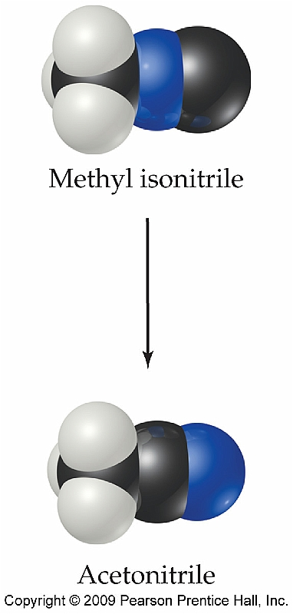
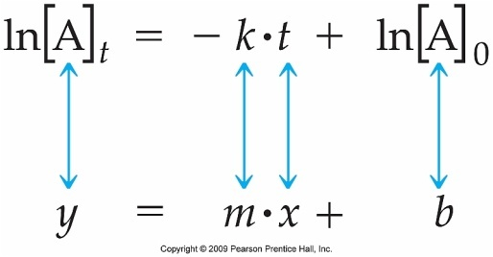
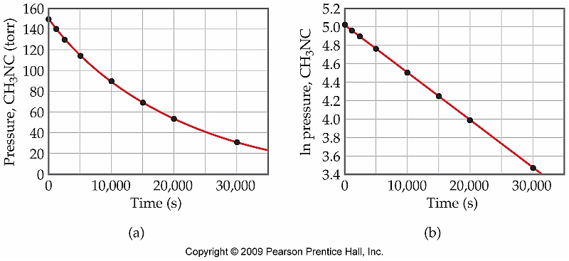
Verifying Order of Reaction Using Integrated Rate Law
CH₃NC → CH₃CN (isomerization)

Slide 25
Second Order Reactions and the Integrated Rate Law
The rate law for a second order reaction can be expressed as follows:
By integrating the equation above, we obtain the integrated rate law:

Slide 26
Determining Reaction Order from the Integrated Rate Law
Nitrosyl chloride decomposes to nitrogen monoxide and chlorine at increased temperatures. Determine the rate constant and order from the concentration-time dependence.
NOCl(g) → NO(g) + ½Cl₂(g)

Slide 27
Determining Reaction Order from the Integrated Rate Law
Time (s) | [NOCl] (M) | ln[NOCl] | 1/[NOCl]
0 | 0.100 | -2.30 | 10
30 | 0.064 | -2.75 | 15.6
60 | 0.047 | -3.06 | 21.3
100 | 0.035 | -3.35 | 28.6
200 | 0.021 | -3.86 | 47.6
300 | 0.015 | -4.20 | 66.7
400 | 0.012 | -4.42 | 83.3
y = 0.185x + 10.21

Slide 28
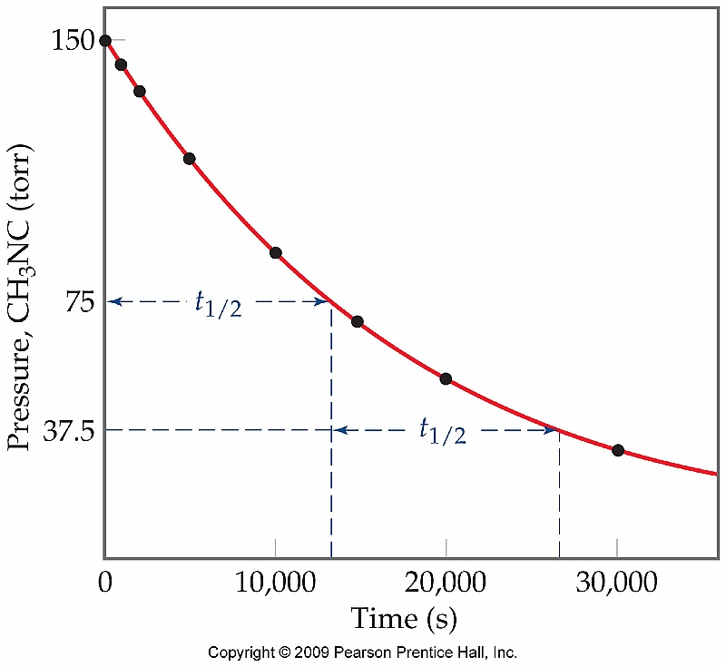
Reaction Half-Life
The half-life for a chemical reaction is fundamentally the same as radioactive half-life
  Time required for the concentration of a reactant to decrease by half

Slide 29
Half-Life Expressions
Depending on the order of the reaction the expression for half life will be different:
  Notice that the half-life for a first order reaction is independent of reactant concentration
First Order
Second Order

Slide 30
Calculating Half-Life
Consider the reaction
A → B with the data shown below. Determine whether the reaction is first order or second order. What is the value of the rate constant for the reaction? What is the half-life for the reaction?
Time (s) | [A] (M)
0 | 0.100
40 | 0.067
80 | 0.045
120 | 0.030
160 | 0.020

Slide 31
Calculating Half-Life (cont.)
Time (s) | [A] (M) | ln[A] | 1/[A]
0 | 0.100
40 | 0.067
80 | 0.045
120 | 0.030
160 | 0.020
-2.30
-2.70
-3.10
-3.51
-3.91
10.0
14.9
22.2
33.3
50.0
y = -0.0101x - 2.298

Slide 32
The Collision Model of Chemical Reactivity
In order for a chemical reaction to occur, the individual molecules of reactant must collide with one another
  Rate of reaction is therefore directly related to the rate of collisions between reactant molecules

Slide 33
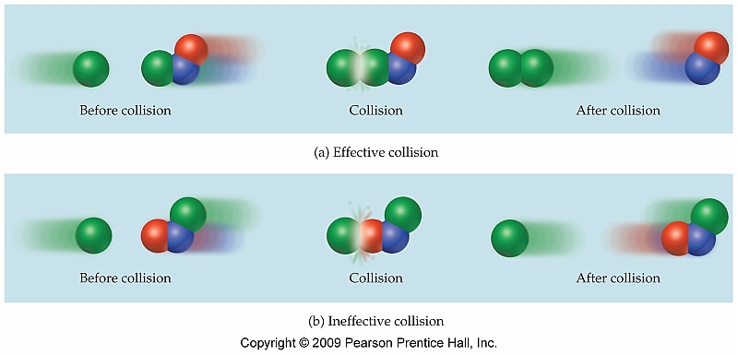
Orientation Factor
Not every reactant collision is equal (i.e. not every collision produces a chemical reaction to form a product
  Orientation must be correct:

Slide 34

Activation Energy
In order for a chemical reaction to occur the reactants must have a minimum amount of kinetic energy
  This minimum amount of KE is referred to as the activation energy, E_{a}

Slide 35
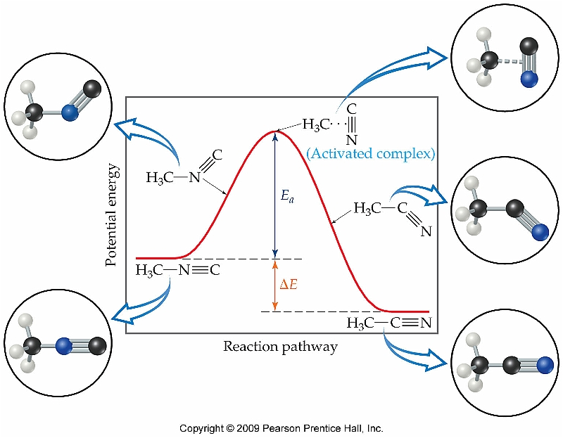
Activation Energy and Energy Profiles

Slide 36
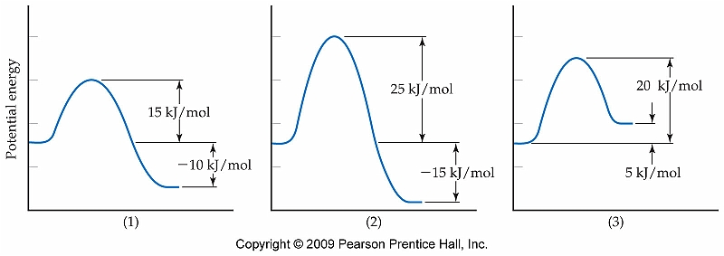
Comparing Energy Profiles
If the activation energy is known
the fraction of molecules with
enough KE required for reaction
can be determined for a given T

Slide 37
The Arrhenius Equation
Arrhenius realized that the rates of reactions depend on three essential factors: a.) fraction of molecules possessing sufficient E_{a}, b.) number of collisions per second, c.) fraction that have the appropriate orientation for reaction
  These factors are incorporated in the following expression:

Slide 38
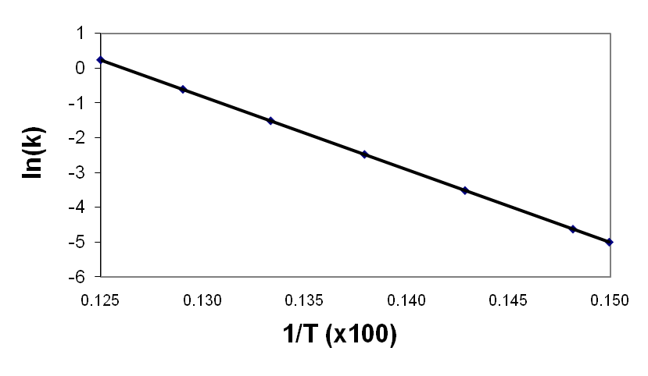
Integrating the Arrhenius Equation
When the Arrhenius equation is integrated, the following expression is obtained:
T (K) | Rate Constant | ln(k)
667 | 6.79 x 10⁻³ | -4.99
675 | 9.86 x 10⁻³ | -4.62
700 | 2.99 x 10⁻² | -3.51
725 | 8.43 x 10⁻² | -2.47
750 | 2.21 x 10⁻¹ | -1.51
775 | 5.46 x 10⁻¹ | -.605
800 | 1.27 | -0.239
y = -209.93x + 0.026481
Because the y-intercept is essentially ln(A), we can determine the frequency factor, A, by analyzing a plot of ln(k) vs. 1/T.

Slide 39
Determining Activation Energy
Calculate the activation energy, E_{a} from the data on the previous slide and determine the value of the rate constant at 450 K.

Slide 40
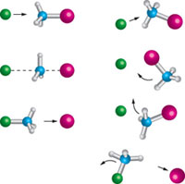
Reaction Mechanisms
A balanced chemical equation yields information about what species take part in the reaction, but tells nothing about how the reaction actually takes place
  How a reaction actually occurs is referred to as the reaction mechanism

Slide 41
Molecularity
Reactions that occur in a single step are referred to as elementary reactions
  Some reactions occur in a series of elementary reactions
The number of molecules participating in an elementary reaction determine its molecularity
  Similar to reaction order
  Ex: HCl → H + Cl
  NO₂ + NO₂ → N₂O₄
  NO + NO₂ + O₂ → NO₂ + NO₃

Slide 42
Multistep Mechanisms
A multistep mechanism is simply a combination of elementary reactions
  Ex: NO₂(g) + CO(g) → NO(g) + CO₂(g)
A multistep mechanism involves the production of intermediates that do not appear in the balanced chemical equation

Slide 43
Determining Molecularity and Identifying Intermediates
It has been proposed that NO₂F is produced via the following reactions:
NO₂(g) + F₂(g) → NO₂F(g) + F(g)
NO₂(g) + F(g) → NO₂F(g)
a.) Describe the molecularity of each
elementary reaction
b.) Write the equation for the overall
reaction
c.) Identify all intermediates
See Sample Exercise 13.13 (Pg. 549)

Slide 44
Rate Laws for Elementary Reactions
If a reaction is an elementary reaction, the rate law is based directly on the stoichiometry of the reaction:
Ex: Assume each reaction is an elementary reaction. What is the rate law for each reaction?
  HCl → H + Cl
  NO₂ + NO₂ → N₂O₄
  NO + NO₂ + O₂ → NO₂ + NO₃

Slide 45
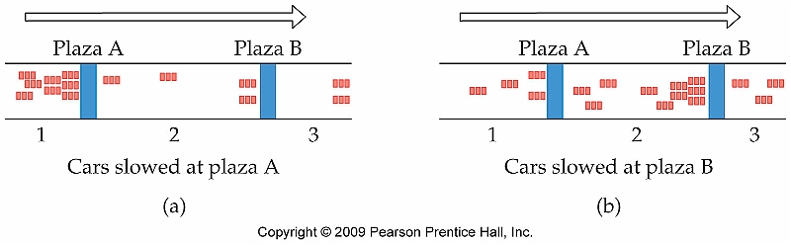
The Rate-Determining Step for Multistep Mechanisms
For a reaction mechanism that involves more than one step, the step that is the slowest is referred to as the rate determining step
  Can be thought of as a “weakest link”
The rate determining step limits the overall rate of the reaction

Slide 46
Slow Initial Step
The following mechanism has been proposed:
2NO₂ + O₃ → N₂O₅ + O₂
NO₂ + O₃ → NO₃ + O₂ Slow
NO₃ + NO₂ → N₂O₅ Fast
Propose a rate law based on this mechanism

Slide 47
Fast Initial Step
The following mechanism has been proposed:
2NO₂ + O₃ → N₂O₅ + O₂
2NO₂ N₂O₄ Fast, reversible
N₂O₄ + O₃ → N₂O₅ + O₂ Slow
Propose a rate law based on this mechanism

Slide 48
Evaluating Reaction Mechanisms
The gas phase reaction of nitrogen monoxide with chlorine proceeds to form nitrosyl chloride.
2NO(g) + Cl₂(g) → 2NOCl(g)
rate = k[NO]²[Cl₂]
Evaluate the following proposed mechanism to determine whether it is consistent with the experimental results, and identify intermediates, if any.
2NO N₂O₂ Fast, reversible
N₂O₂ + Cl₂ → 2NOCl Slow

Slide 49
Catalysis
A catalyst is a chemical species that speeds up the rate of a reaction but is not consumed (and is potentially recoverable) during the course of the reaction
  Ex: catalytic converters, enzymes
Classified into two broad categories:
  Homogeneous vs. Heterogeneous

Slide 50
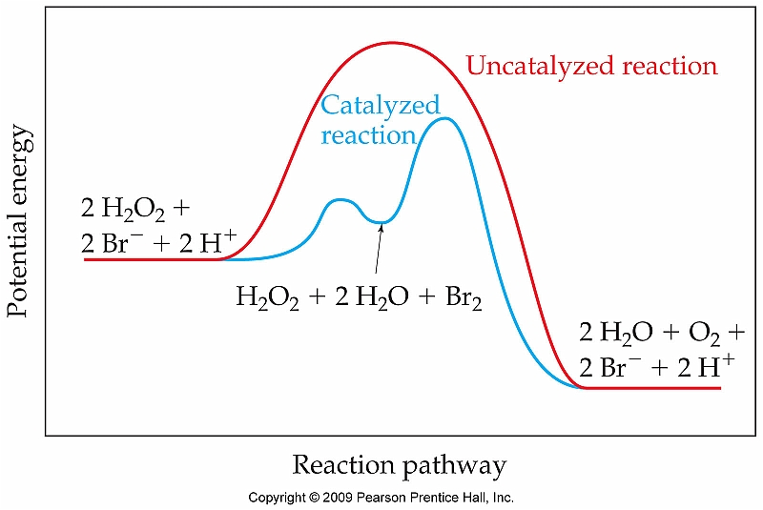
Catalysis and the Arrhenius Equation
Catalysts work by altering either E_{a} or A
  Most effective catalysts alter E_{a}

Slide 51
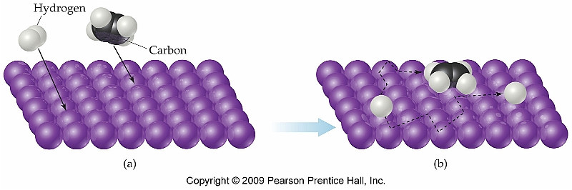
Heterogeneous Catalysis
Usually involves adsorption of one of the reagents onto the surface of the catalyst

Slide 52
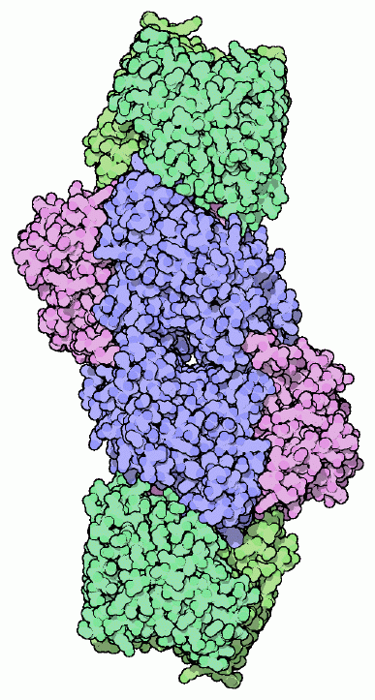
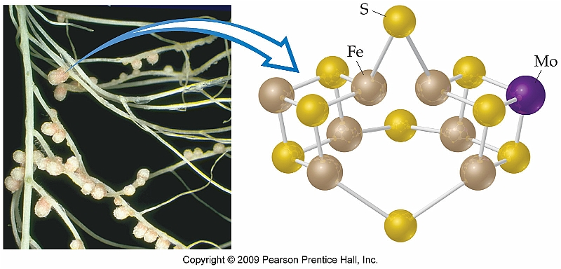
Enzymes
Enzymes provide their dramatic effect on reaction rate by providing a preorganized transition state
  Ex: Nitrogenase catalyzes the conversion of N₂ into NH₃
MM = 216000-270000 g/mol

Slide 53
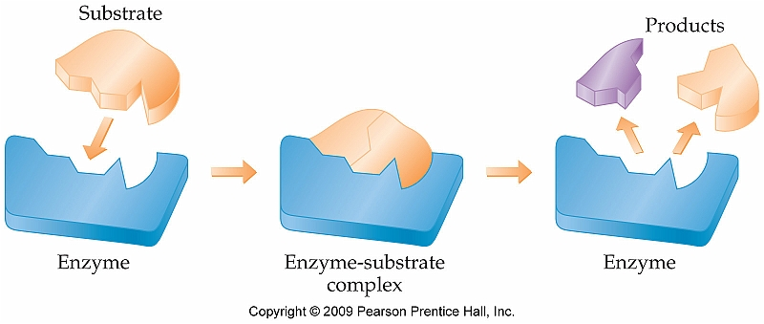
Lock and Key Model of Enzyme Catalysis
The Lock and Key Model is a very simplified view of how enzymes catalyze reactions
  Substrates are forced into an active site that has a preorganized geometry that perfectly matches the transition state of the reaction being catalyzed

