Slide 1
Chapter 6
The Gaseous State

Slide 2
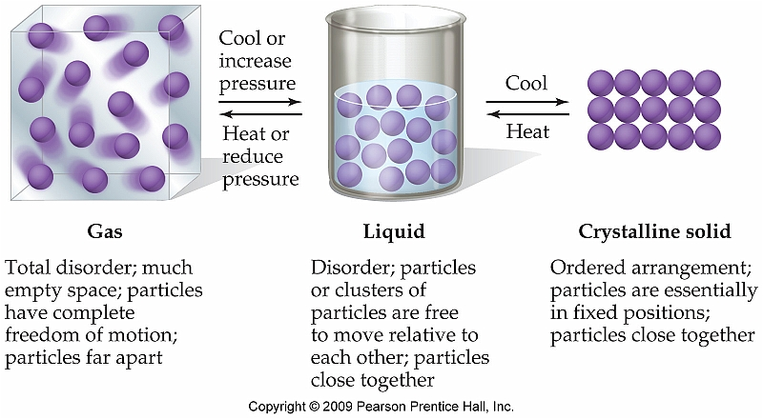
An Overview of the Phases of Matter
Gases are essentially characterized as a fluid that will expand to occupy the entire volume of whatever container it is in
(i.e. No fixed volume or shape)

Slide 3
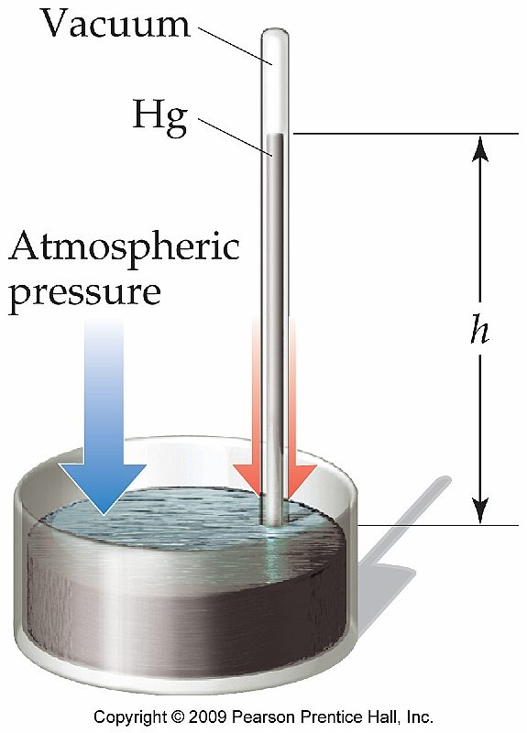
Pressure and It’s Units
Standard atmospheric pressure refers to the pressure required to support a column of Hg(l) 760 mm high
Can be expressed in a variety of units:
1 atm = 760 mm Hg = 760 torr = 101.325 kPa

Slide 4
The Gas Laws
There are four physical parameters that govern the properties of gases
Pressure, volume, temperature, amount (mol)
As a result there are several “laws” that describe relationship between several of these properties

Slide 5
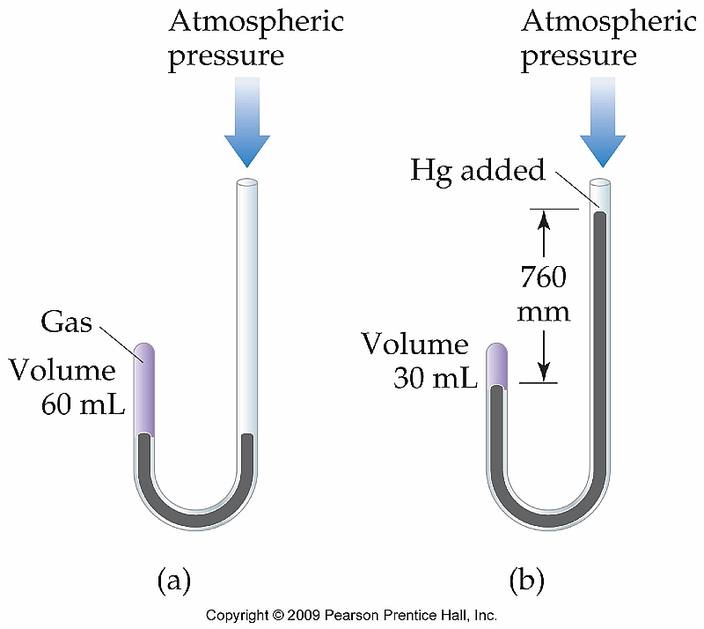
Boyle’s Law (Pressure/Volume)
Robert Boyle is credited with experimentally determining the relationship between pressure and volume of gases
P₁V₁ = P₂V₂

Slide 6
Example
A sample of gas occupies a volume of 135 mL at 165 torr. What would the resulting pressure be if the container was expanded to a volume of 252 mL?

Slide 7
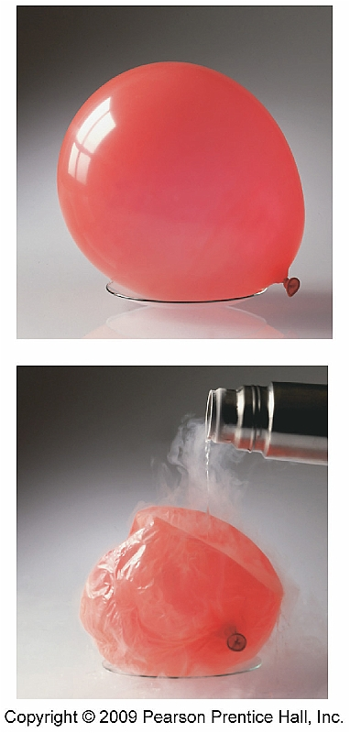
Charles’s Law (Temperature/Volume)
Jacques Charles set forth the relationship between temperature and volume

Slide 8
Example
A weather balloon is filled to a volume of 135 L at 21 ºC. What would the volume be at a high altitude where the temperature is approximately 8 ºC?

Slide 9
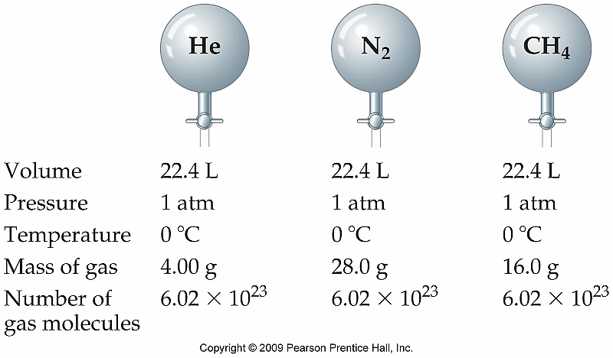
Avogadro’s (or Gay-Lussac’s) Law (Quantity/Volume)
The volume of a gas is directly proportional to the number of moles of gas present in the sample, regardless of mass.
Only holds true at the same pressure and temperature.

Slide 10
The Combined Gas Law
For a given amount of gas it is possible to derive a formula which relates the other three properties of a gas (pressure, volume, and temperature) simultaneously:

Slide 11
Example
A sample of hydrogen gas is in a 2.33 L container at 745 torr and 27 ºC. Express the pressure of hydrogen after the volume is changed to 1.22 L and the temperature is increased to 100 ºC.

Slide 12
The Ideal Gas Law
An even better combination of the gas laws results in the following equation which is typically the most useful:
PV = nRT

Slide 13
What is R?
The ideal gas law contains a constant that remains the same no matter what type of gas is being analyzed.
R = 0.08206 L atm/mol K

Slide 14
Example
Calculate the number of moles of gas contained in a 3.0 L vessel at 300 ºC with a pressure of 876 mm Hg.

Slide 15
Stoichiometry Calculations Involving Gases
Because reactions frequently involve gases as either reactants or products, it is possible to apply the ideal gas provided the other parameters are known (pressure, temperature, etc.)
Ex: 2Li(s) + 2H₂O(l) → 2LiOH(aq) + H₂(g)

Slide 16
Example
Heating potassium chlorate, KClO₃, yields oxygen gas and potassium chloride. What volume, in liters, of oxygen at 23 ºC and 760 torr is produced by the decomposition of 4.42 g of potassium chlorate?

Slide 17
Example #2
Ammonia gas is synthesized by combining hydrogen and nitrogen according to the equation below. If you want to produce 562 g of NH₃, what volume of H₂ gas, at 56 ºC and 745 torr is required?
3H₂(g) + N₂(g) → 2NH₃(g)

Slide 18
Volumes of Gases in Chemical Reactions
We have already discussed how all gases occupy the same volume at a given temperature and pressure
As a result of this, we can not only directly relate moles in a balanced chemical equation, but also volume (L)

Slide 19
Example
3H₂(g) + N₂(g) → 2NH₃(g)
Can be read in two distinct (and equally correct) ways:
3 mol H₂ + 1 mol N₂ yields 2 mol NH₃
OR
3 L H₂ + 1 L N₂ yields 2 L NH₃

Slide 20
Sample Problem
What volume of H₂O will be produced if you combust 3.45 L of CH₄ with 8.61 L of oxygen as shown in the balanced equation below?
CH₄(g) + 2O₂(g) → CO₂(g) + 2H₂O(g)

