Slide 1
Chapter 5
Gases

Slide 2
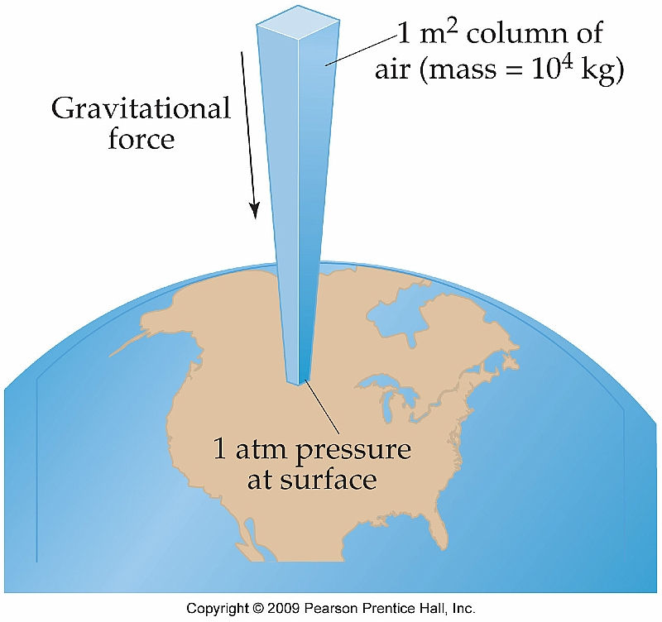
Section 5.1 Pressure
In physical terms pressure is defined as force per unit area (P = F/A)
This idea can be extended to include the force applied by a column of air on the Earth’s surface

Slide 3
Atmospheric Pressure
This pressure applied by the gas of the atmosphere (or atmospheric pressure) can be derived as follows:
Imagine a column of air 1 m² at its base and extending to the upper atmosphere
F = ma
F = (10,000 kg)(9.8 m/s²) = 1 × 10⁵ N

Slide 4
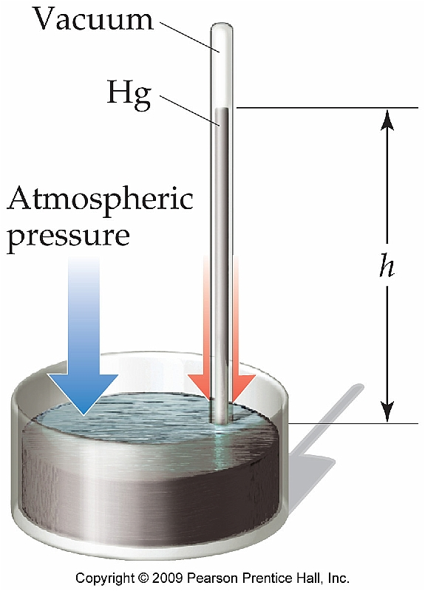
Standard Atmospheric Pressure
Standard atmospheric pressure refers to the pressure required to support a column of Hg(l) 760 mm high
Can be expressed in a variety of units:
1 atm = 760 mm Hg = 760 torr = 101.325 kPa

Slide 5
Section 5.2--The Gas Laws of Boyle, Charles, and Avogadro
There are four physical parameters that govern the properties of gases
Pressure, volume, temperature, amount (mol)
As a result there are several “laws” that describe relationship between several of these properties

Slide 6
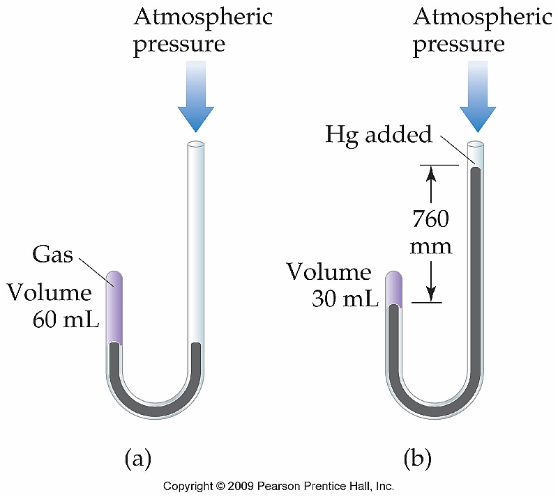
Boyle’s Law (Pressure/Volume)
Robert Boyle is credited with experimentally determining the relationship between pressure and volume of gases
PV = constant

Slide 7
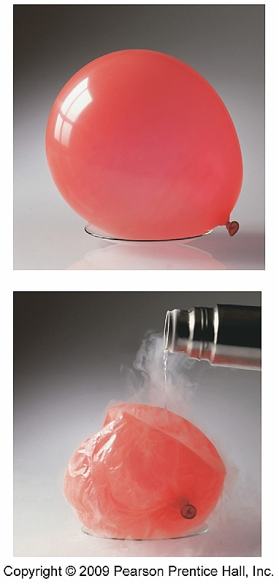
Charles’s Law (Temperature/Volume)
Jacques Charles set forth the relationship between temperature and volume
V/T = constant

Slide 8
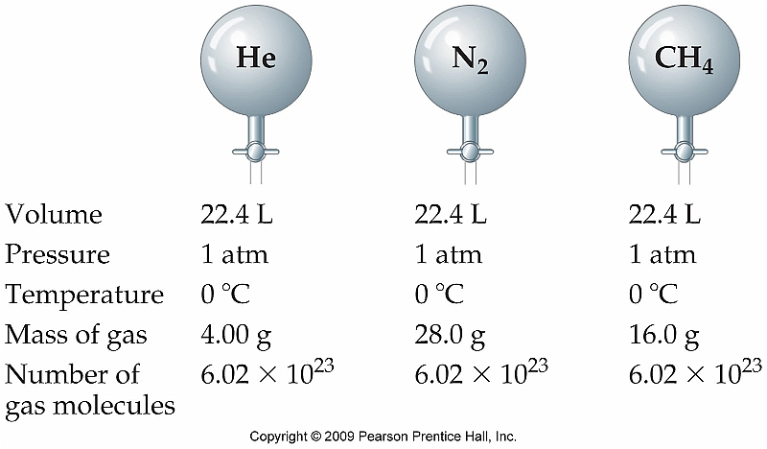
Avogadro’s Law (Quantity/Volume)
The volume of a gas is directly proportional to the number of moles of gas present in the sample, regardless of mass.
Only holds true at the same pressure and temperature.
V/n = constant

Slide 9
Section 5.3 The Ideal Gas Law
The equation below holds true only if a gas behaves as an “ideal gas” as opposed to a “real gas”
PV = nRT

Slide 10
Standard Temperature and Pressure (STP)
It is sometimes helpful to be able to quickly equate a volume of gas with the number of moles
This can only be done at 1.00 atm and 0° C (273 K)
Also known as standard temperature and pressure (STP)

Slide 11
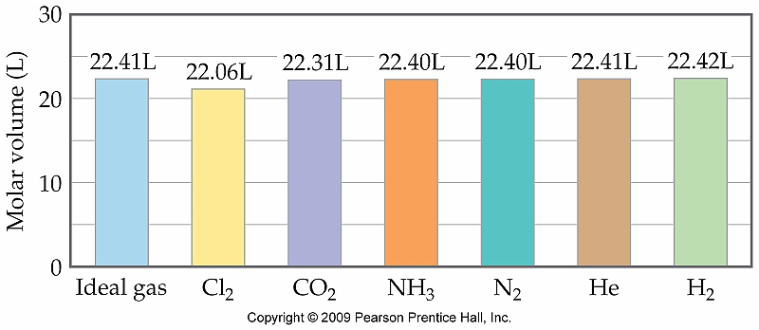
Comparison of Molar Volumes

Slide 12
Example
Calculate the pressure of a 1.2 mol sample of methane gas in a 3.3 L container at 25 °C.
See Interactive Example 5.6 (Pg. 174)

Slide 13
Volumes of Gases in Chemical Reactions
Avogadro’s Law states that one mole of any gas occupies the same volume at a given temperature and pressure
Therefore a balanced chemical reaction can be used to directly relate volumes of gases
3H₂(g) + N₂(g) → 2NH₃(g)

Slide 14
Example
Hydrogen, H₂, and chlorine, Cl₂, react to form hydrochloric acid, HCl. Calculate the volume of HCl formed by reacting 2.34 L of H₂ and 3.22 L of Cl₂.

Slide 15
Section 5.4—Gas Stoichiometry
Chemists frequently prepare hydrogen gas in the laboratory by reacting Zn metal with hydrochloric acid. The other product is ZnCl₂. Calculate the volume of hydrogen produced at 744 torr pressure and 27 °C by the reaction of 32.2 g of Zn and 500.0 mL of 2.2 M HCl.
See Interactive Example 5.13 (Pg. 180)

Slide 16
Section 5.5--Dalton’s Law of Partial Pressures
Dalton discovered that a mixture of gases will behave as if each individual gas were present all alone
As a result, the individual, or partial, pressures of each gas must equal the total pressure of the entire system:
P_{t} = P₁ + P₂ + P₃ + P_{n}

Slide 17
Applying Dalton’s Law of Partial Pressures
A gas sample in a 1.22 L container holds 0.22 mol N₂ and 0.13 mol O₂. Calculate the partial pressure of each gas and the total pressure at 50 °C.
See Interactive Example 5.15 (Pg. 184)

Slide 18
Partial Pressure and Mole Fractions
Because the pressures of each individual gas are directly related to the number moles of that gas present (through the ideal gas law), we can express this as a mole fraction

Slide 19
Relating Mole Fractions and Partial Pressures
What is the partial pressure of each gas in a flask that contains 2.3 g neon, 0.33 g xenon, and 1.1 g argon, if the total pressure in the flask is 2.6 atm?
See Interactive Example 5.16 (Pg. 187)

Slide 20
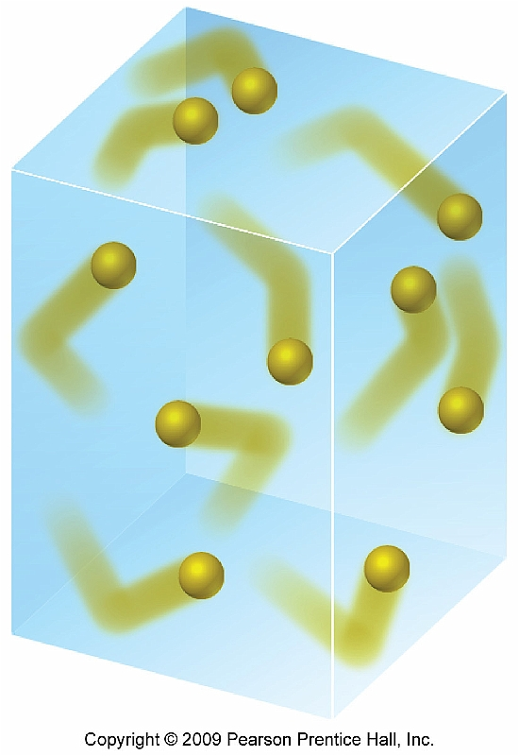
Kinetic-Molecular Theory Section 5.6
Up to this point we have discussed gases as behaving “ideally”
However, this is not an accurate description of the true behavior of gases

Slide 21
Summary of Kinetic Molecular Theory
Gases exist as small “billiard balls” that are in constant, random motion.
The volume of these individual molecules is negligible
Any intermolecular forces between molecules of gases are negligible
Energy may be transferred between gas molecules but the overall energy level remains constant
The average kinetic energy is proportional to the absolute temperature

Slide 22
Distributions of Molecular Speed
All of the gas particles will not move at the exact same speed at a given temperature
Instead, the bulk sample will have an average or root-mean-square speed
The rms speed is directly related to the kinetic energy of the gas molecules:

Slide 23
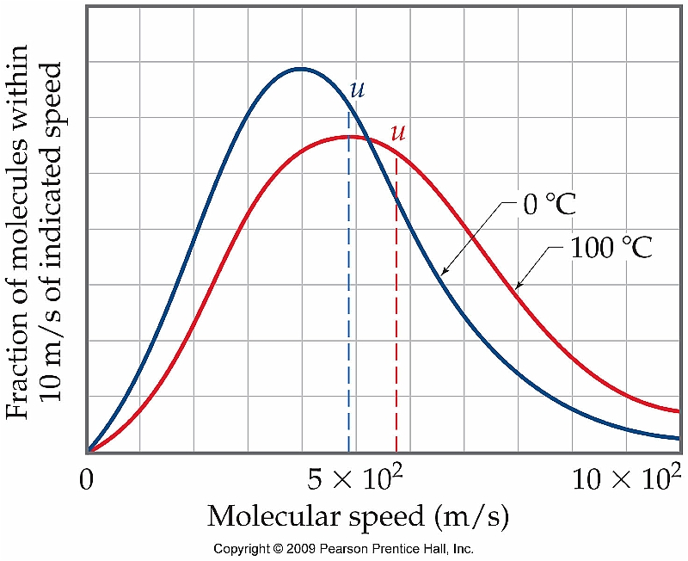
Effect of Temperature on RMS
Because not all of the molecules of a gas move at a constant speed, an increase in temperature will only shift the distribution

Slide 24
Molecular Effusion and Diffusion Section 5.7
According to kinetic molecular theory, any collection of gas molecules will have the same kinetic energy at a given temperature
However, as the mass of the individual gas particles increases, the speed of those particles must decrease:
kinetic molecular theory

Slide 25
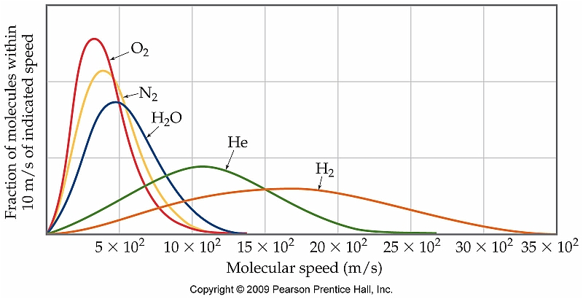
Mass vs. Speed

Slide 26
Calculating RMS speed
Calculate the rms speed of Ar atoms at 27 ^{º}C.
For this problem R is still the universal gas constant only with different units!!!
See Interactive Example 5.19 (Pg. 195)

Slide 27
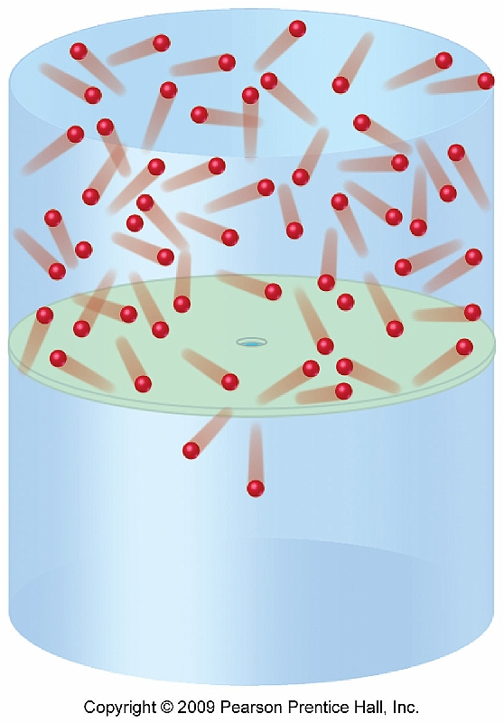
Graham's Law of Effusion
Difference between diffusion and effusion:
Diffusion occurs as a gas fills up a given space; effusion occurs as a gas escapes from an enclosed container

Slide 28
But How?
Graham's Law can actually be derived from
the equation involving kinetic energy of
individual particles:

Slide 29
Applying Graham's Law
Calculate the molar mass of a gas if equal volumes of nitrogen and the unknown gas take 2.2 and 4.1 minutes, respectively, to effuse through the same small hole at constant temperature and pressure.
See Interactive Example 5.20 (pg. 197)

Slide 30
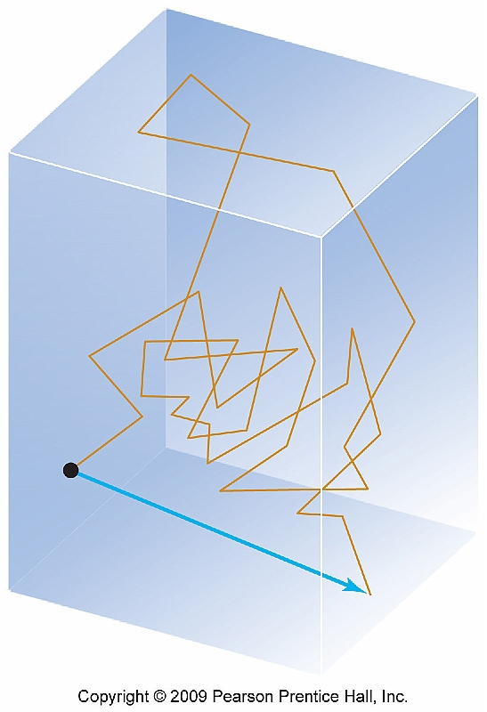
Diffusion and Mean Free Path
Diffusion of gases is a much slower process than effusion
The equation for effusion does not hold true for a diffusion process
Collisions between gas molecules must be taken into consideration

Slide 31
Effects of Pressure and Temperature
Increasing the pressure will decrease the mean free path
Increase in pressure squeezes molecules closer together
An increase in temperature, however, has no effect
Particles are moving faster but they are not squeezed closer together

Slide 32
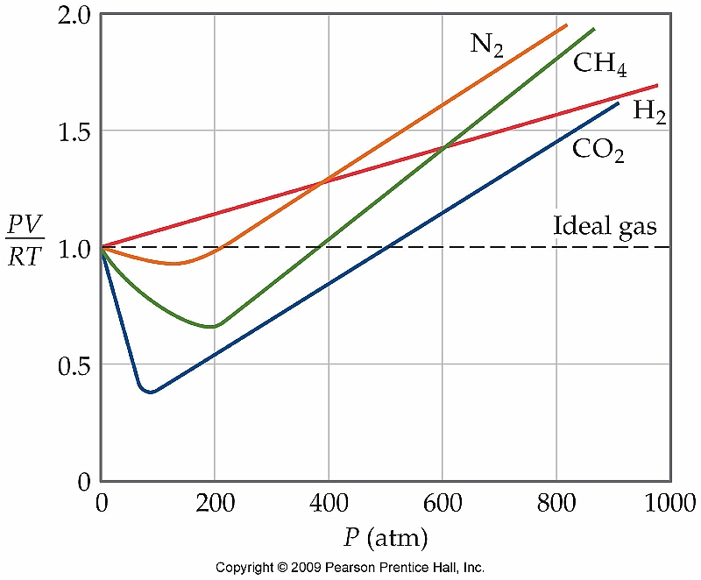
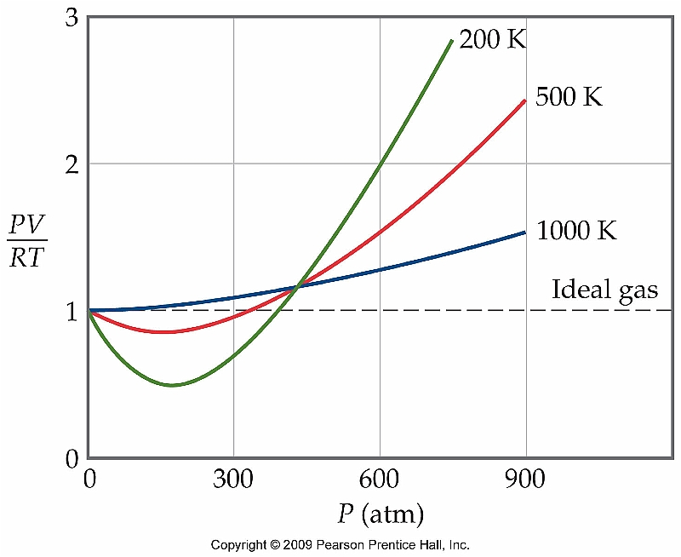
Real vs. Ideal Gases Section 5.8
In real life, gases are assumed to behave "ideally" so that simple calculations can be easily made
However, a distinction can be made for "real" vs. "ideal" gases

Slide 33
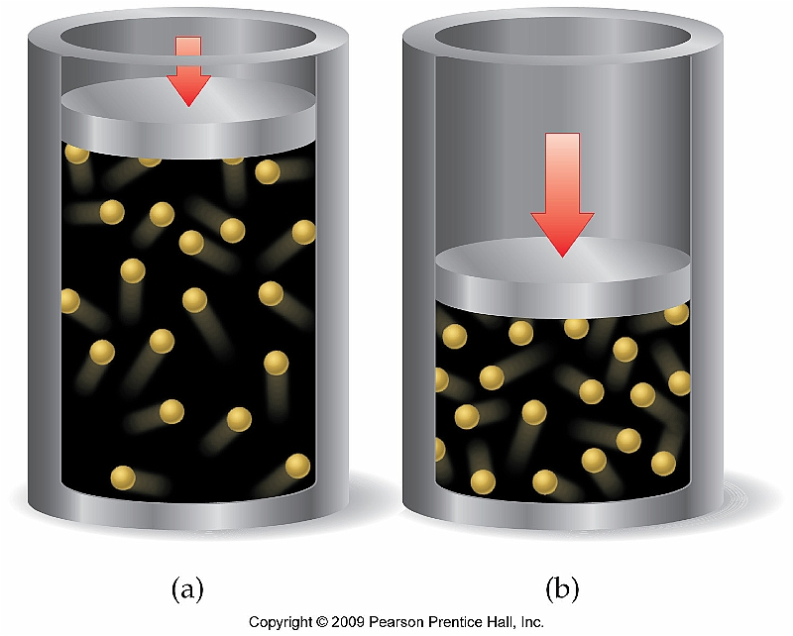
Conditions Affecting the Ideal Nature of a Gas
Pressure
Gases become less ideal at high pressure
Temperature
Gases become less ideal at low temperature
WHY?
As gas molecules approach one another, intermolecular forces cannot be ignored

Slide 34
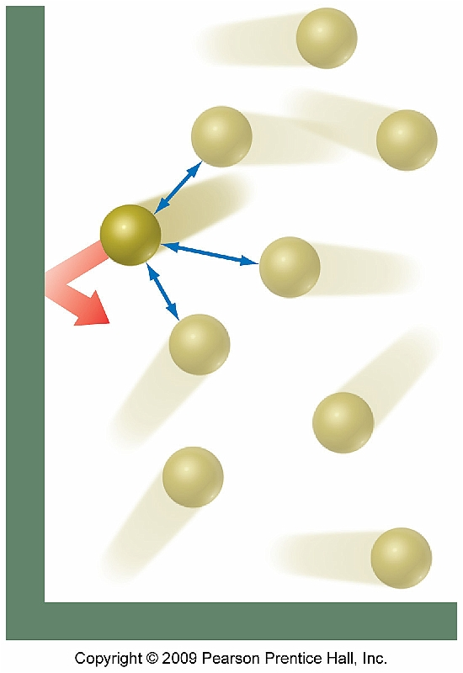
Intermolecular Forces' Effect on Pressure
Pressure from a gas is due
to collisions with the walls
of its container
--Intermolecular forces
change the effect of these
collisions

Slide 35
The van der Waals Equation
In order to more accurately calculate the properties of a gas under real conditions, fudge factors must be used which are unique to the gas being studied:

Slide 36
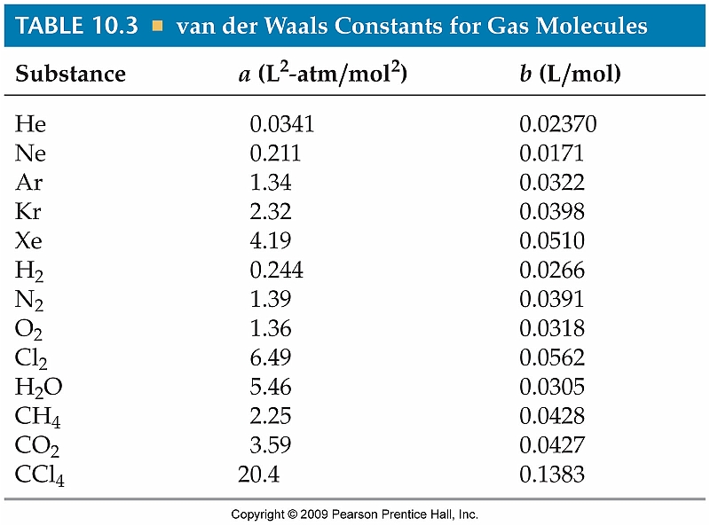
van der Waals Constants

Slide 37
Using the van der Waal's Equation
Calculate the pressure in atmospheres of 2.01 moles of gaseous water at 400 ^{º}C in a 2.55 L container using both the van der Waals equation and the ideal gas law and compare your answers.

