Slide 1
Types of Chemical Reactions and Solution Stoichiometry
Chapter 4

Slide 2
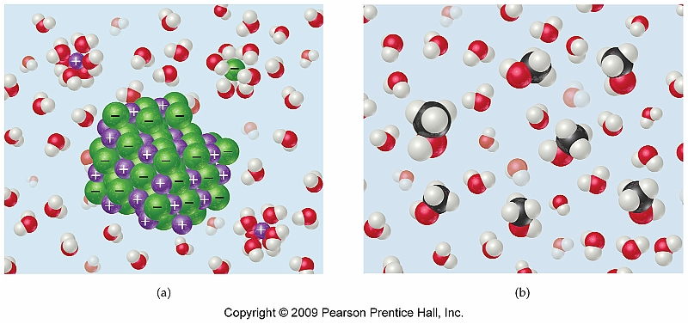
Section 4.2 The Nature of Aqueous Solutions: Strong and Weak Electrolytes
All solutions consist of a solute and a solvent
Solvent consists of the bulk material and makes up most of the volume of the solution
Solute exists as the minor constituent

Slide 3
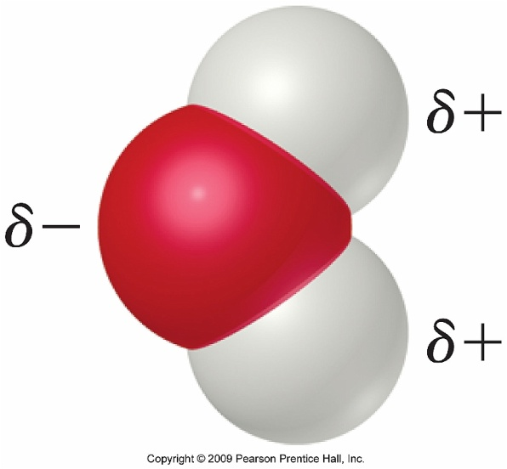
Solvation Process
The solvation process for any ionic compound involves the stabilization of both the cation and the anion.
For molecular compounds those that contain polar groups are more soluble than those that do not
Example: CH₃OH vs. C₄H₁₀

Slide 4
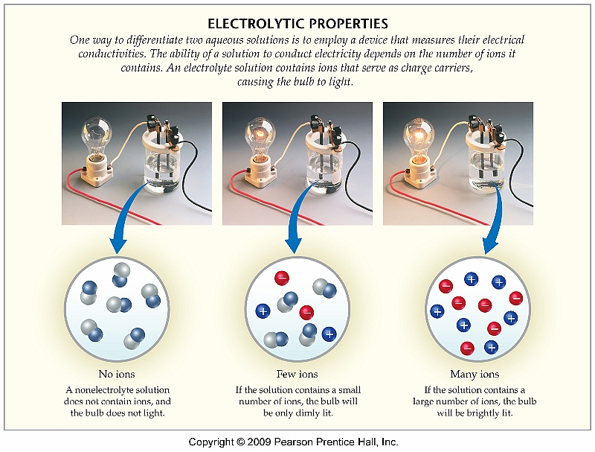
Electrolyte vs. Nonelectrolyte
Electrolytes are solutes that dissociate into ions in an aqueous solution and are capable of conducting electricity
Nonelectrolytes are made up of molecular compounds, that while may be soluble in aqueous solution, do not conduct electricity

Slide 5
Strong vs. Weak Electrolytes and Chemical Equilibrium
While most ionic compounds are electrolytes, some molecular compounds are weak electrolytes as well
Many of these weak electrolytes are known as organic acids
Weak electrolytes exist in a chemical equilibrium:
CH₃COOH(l) CH₃COO⁻(aq) + H⁺(aq)

Slide 6
Examples
Strong Electrolytes
HCl
NaCl
CaCl₂
NH₄Cl
KNO₃
Weak Electrolytes
CH₃COOH (acetic acid)
C₆H₅COOH (benzoic acid)
NH₃ (ammonia)
C₅H₅N (pyridine)

Slide 7
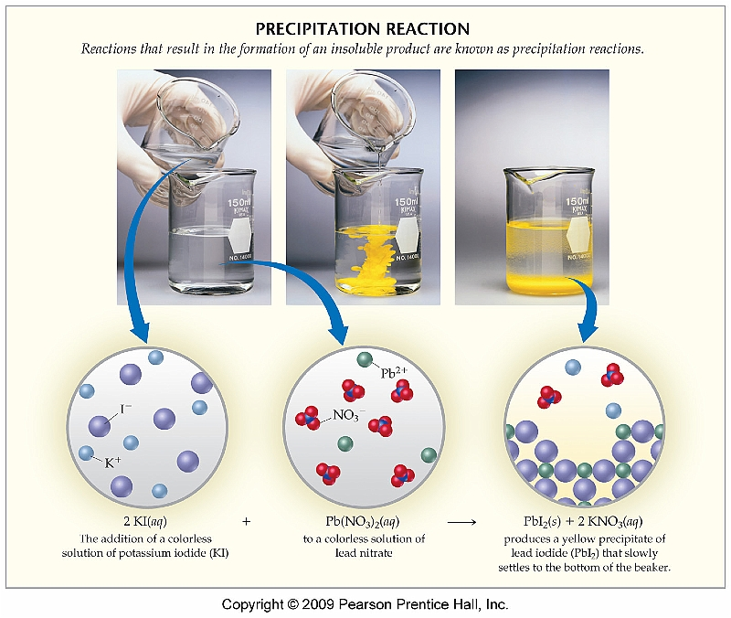
Section 4.5 Precipitation Reactions
One type of reaction that can occur in aqueous solution is known as a precipitation reaction
One compound is formed which is insoluble in aqueous solution and therefore precipitates

Slide 8
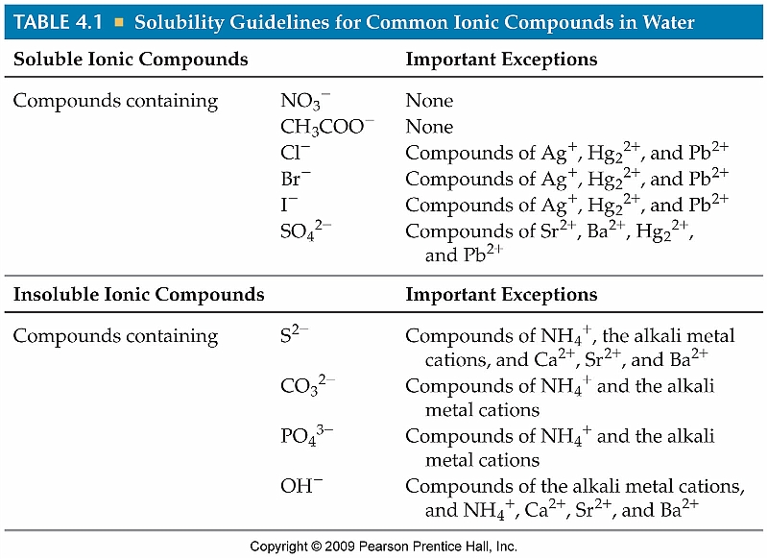
DO NOT MEMORIZE THESE!!!!!!

Slide 9
Solubility Rules
These are the only solubility rules for which you are responsible:
All nitrates are soluble
All acetates are soluble
All compounds containing ammonium or an alkali metal are soluble

Slide 10
Section 4.6 Describing Reactions in Solution
Writing net ionic equations involves determining what ions take part in a metathesis reaction
In order to determine a net ionic equation a total ionic equation must first be written

Slide 11
Steps to Writing Net Ionic Equations
Write the products of the metathesis reaction
Break each soluble reactant or product into its constituent ions
Cross ions that appear on both sides of the equation
The remainder of the species constitutes the net ionic equation

Slide 12
Examples
lead (II) nitrate reacts with potassium iodide and a precipitate is formed
sodium nitrate is mixed with potassium chloride

Slide 13
Spectator Ions
Those ions that do not take place in the reaction are known as spectator ions
Appear (in the same physical state) on both sides of the reaction
Pb⁺²(aq) + 2NO₃⁻(aq) + 2K⁺(aq) + 2I⁻(aq) →
PbI₂(s) + 2K⁺(aq) + 2NO₃⁻(aq)
Pb⁺²(aq) + 2I⁻(aq) → PbI₂(s)
Net Ionic Equation

Slide 14
Section 4.8 Acid-Base Reactions
Acids are compounds that, when placed in aqueous solution, produce H⁺ ions
Ex: HCl(g) → H⁺(aq) + Cl⁻(aq)
Bases are compounds, that when place in aqueous solution, produce OH⁻ ions.
Ex: NaOH(s) → Na⁺(aq) + OH⁻(aq)

Slide 15
Neutralization
A reaction between an acid and a base is referred to as a neutralization reaction
Always produces water (H₂O) and a salt
HCl(aq) + NaOH(aq) → NaCl(aq) + H₂O(l)
Acid
Base
“Salt”
Water

Slide 16
Net Ionic Equ. for Neutralization
HCl(aq) + NaOH(aq) → NaCl(aq) + H₂O(l)
Acid
Base
Salt
Water
Total Ionic Equation
H⁺(aq) + Cl⁻(aq) + Na⁺(aq) + OH⁻(aq) →
Na⁺(aq) + Cl⁻(aq) + H₂O(l)
Net Ionic Equation
H⁺(aq) + OH⁻(aq) → H₂O(l)

Slide 17
Section 4.9 Oxidation-Reduction Reactions
Oxidation/Reduction, often called redox reactions, involve the transfer of electrons between compounds
Oxidation occurs when species lose electrons
Reduction occurs when species gain electrons

Slide 18
Assigning Oxidation Numbers
Any atom in its elemental form has an oxidation state of 0
Any monatomic ion has the same oxidation number as charge
Nonmetals typically have negative oxidation numbers (although sometimes positive) and are typically determined by analyzing the other atoms present
All oxidation numbers must add up to the total charge for the compound or ion

Slide 19
Assigning Oxidation Numbers
Refer to Pg. 149 for rules on assigning oxidation number
PbO
MnCl₂
Na₂SO₄
PCl₅
See Sample Exercise 4.8 (Pg. 138)

Slide 20
Determining Whether a Redox Rxn has Occurred
For a reaction to be qualified as a redox reaction, an oxidation state change must have occurred.
Example:

Slide 21
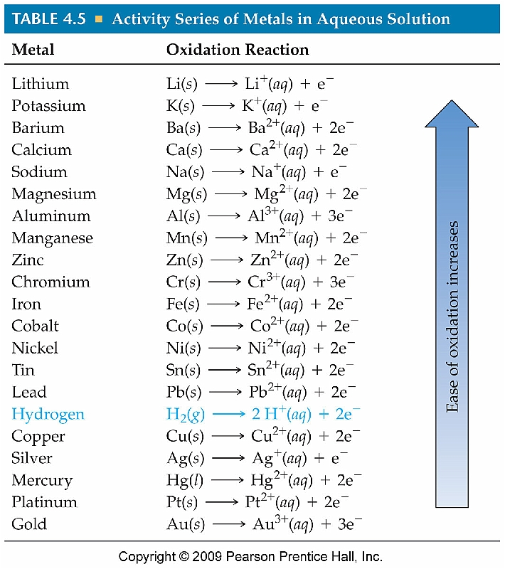
The Activity Series
We can predict whether a redox reaction will occur based on its position on the activity series
Any metal on the list can be oxidized by one below it

Slide 22
Examples
Determine if either of the following reactions will occur:
Cr(s) is mixed with CuSO₄(aq)
Ni(s) and aqueous calcium acetate
See Sample Exercise 4.10 (Pg. 142)

Slide 23
Section 4.3 The Composition of Solutions
There are many different ways to express the concentration of a solution; however the most common is molarity (mol/L)

Slide 24
Example
An IV saline solution is made by dissolving 180. g of NaCl in 20.0 L of solution. What is the molarity of this solution?
See Interactive Example 4.1 (pg. 123)

Slide 25
Calculating Concentration of a Single Electrolyte
What are the molar concentrations of the ions present in a 0.20 M calcium nitrate solution?
See Interactive Example 4.3 (pg. 125)

Slide 26
Calculating Grams of Solute Using Molarity Data
Concentrated nitric acid, HNO₃, is 15.9 M and is frequently sold in 2.50 L bottles. How many grams of HNO₃ are contained in this bottle?
See Interactive Example 4.6 (Pg. 127)

Slide 27
Dilutions
Oftentimes a stock solution of a compound will be utilized to make a series of dilutions
The volume of stock solution required to make a dilution can be quickly and easily calculated using the following equation:
M₁V₁ = M₂V₂

Slide 28
Example
Concentrated HCl is sold as a 12.1 M solution. What volume of this solution is need to prepared 500. mL of 0.250 M HCl?
See Interactive Example 4.7 (Pg. 129)

Slide 29
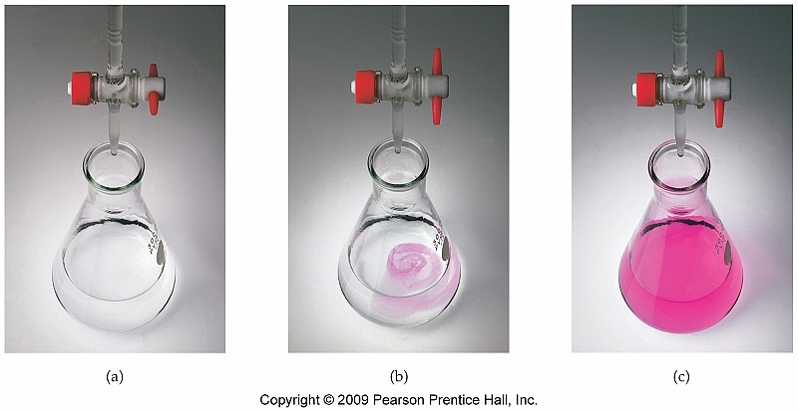
Section 4.7 Stoichiometry of Precipitation Reactions
Solution stoichiometry most often applies to data obtained through a titration
A titration is simply a technique for determining the amount of solute in a given sample
Most often used example is an acid/base reaction

Slide 30
Example
Calculate the mass, in grams, of Al(OH)₃ formed from the reaction of exactly 500. mL of 0.100 M NaOH with excess Al(NO₃)₃
See Interactive Example 4.10 (Pg. 138)

Slide 31
Example #2
To standardize an HCl solution, a chemist weighs 0.210 g of pure Na₂CO₃ into a flask and dissolves in water. She finds that it takes 5.50 mL of HCl to completely react with the Na₂CO₃. Calculate the concentration of HCl
2HCl(aq) + Na₂CO₃(aq) → CO₂(g) + 2NaCl(aq) + H₂O(l)

Slide 32
Example #3
What volume of 0.223 M HNO₃ is required to neutralize 50.00 mL of 0.033 M barium hydroxide?

Slide 33
Example #4
Tin (II) fluoride (stannnous fluoride) is added to toothpaste as a convenient source of fluoride ion, which is known to help minimize tooth decay. The concentration of stannous fluoride in particular toothpaste can be determined by precipitating the fluoride as the mixed salt PbClF according to the equation shown below. The concentrations of Pb⁺² and Cl⁻ are controlled so that PbCl₂ does not precipitate. If a sample of toothpaste that weighs 10.50g produces PbClF precipitate that weighs -0.105 g, what is the mass percentage of SnF₂ in the toothpaste?
SnF₂(aq) + 2Pb⁺²(aq) + 2Cl⁻(aq) → 2PbClF(s) + Sn⁺²(aq)

Slide 34
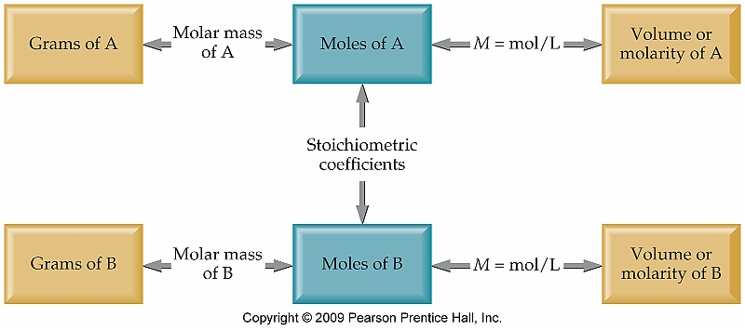
General Guideline for Solution Stoichiometry Problems

