Slide 1
Chapter 3
Process and Process Variables

Slide 2
Process Diagrams and Variables
Input
(Feed)
Output
(Product)
Unit Operation
(Process Unit)
Diagrams are used to describe a process or set of processes
The diagrams incorporate simple boxes for individual unit operations and lines for input and output streams

Slide 3
Section 3.1—Mass and Volume
Density is one of the more important conversion factors because it allows direct conversion between mass and volume
Abbreviated with ρ
Specific gravity is related to density by the use of a reference material’s density:
Most common reference is water, which has a density of 1 g/cm³, 1000 kg/m³, and 62.43 lb_{m}/ft³
Specific gravity is unitless (a ratio of densities)

Slide 4
Sample Density Problem
Calculate the density of mercury in lb_{m}/ft³ using the tabulated specific gravity (13.546).
Calculate the volume in ft³ occupied by 215 kg of mercury.
Example 3.1-1 (pg. 44)

Slide 5
Section 3.2—Flow Rate
Very few industrial processes operate as a batch process
Most occur as a fluid flows in and out of a unit operation (distillation, reactor, heat exchanger, etc.)
Therefore it is more convenient to describe these processes using flow rates
Either mass (mass/time) or volumetric (volume/time) flow rates
Flow rates are distinguished from stationary amounts by the use of a dot:
Ex: m vs. ṁ for mass vs. mass flow rate

Slide 6
Density and Flow Rates
Density can be used with flow rates in the same manner that it can be used with stationary masses or volumes:

Slide 7
Section 3.3—Chemical Composition
Molecular weight
Expressed in various units in this course:
g/mol, kg/kmol, lb_{m}/lb-mol
Ex: Molar mass of water is 18.02 g/mol or 18.02 kg/kmol or 18.02 lb_{m}/lb-mol
lb_{m}/lb-mol = super confusing

Slide 8
Mass and Mole Fractions
Mass fraction
Mole fraction
Notice that mole fraction is expressed with a y in this system and not the χ you may be used to from AP Chem.

Slide 9
Pressure
Pressure = Force/Unit Area
Liquid pressure is directly related to density:
P = ρgh
Frames of reference for pressure:
Absolute pressure
Relative to a vacuum
Gauge pressure
Typically relative to atmospheric pressure
P_{abs} = P_{gauge} + P_{atm}

Slide 10
Pressure Measurement
Most common instrument is a Bourdon gauge
Wide range of uses (very low to very high pressures)
Manometers provide more accurate measurements for P < 3 atm

Slide 11
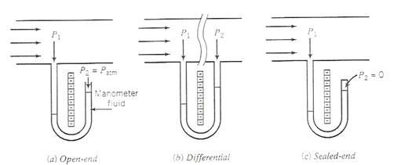
Types of Manometers
Open-end
Usually open to the atmosphere
Differential
Measures a pressure drop between two points in the line
Sealed-end
One end sealed such that a near vacuum is created (P ≈ 0)

Slide 12
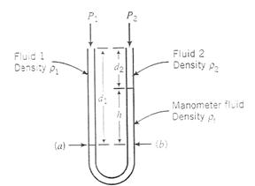
Manometer Equations
General Manometer Equation
Differential Manometer Equation
ρ₁ = ρ₂ ; therefore equation reduces to:
P₁ – P₂ = (ρ_{f} - ρ)gh
Manometer Equation for Gases
No liquids therefore pressure is simply related to the different fluid levels:
P₁ – P₂ = h

Slide 13
Temperature and Temperature Scales
Temperature scales used or referenced:
Celsius, Kelvin, Fahrenheit, Rankine
Conversions:
T(K) = T(°C) + 273.15
T(°R) = T(°F) + 459.67
T(°R) = 1.8T(K)
T(°F) = 1.8T(°C) + 32

